Slide 1
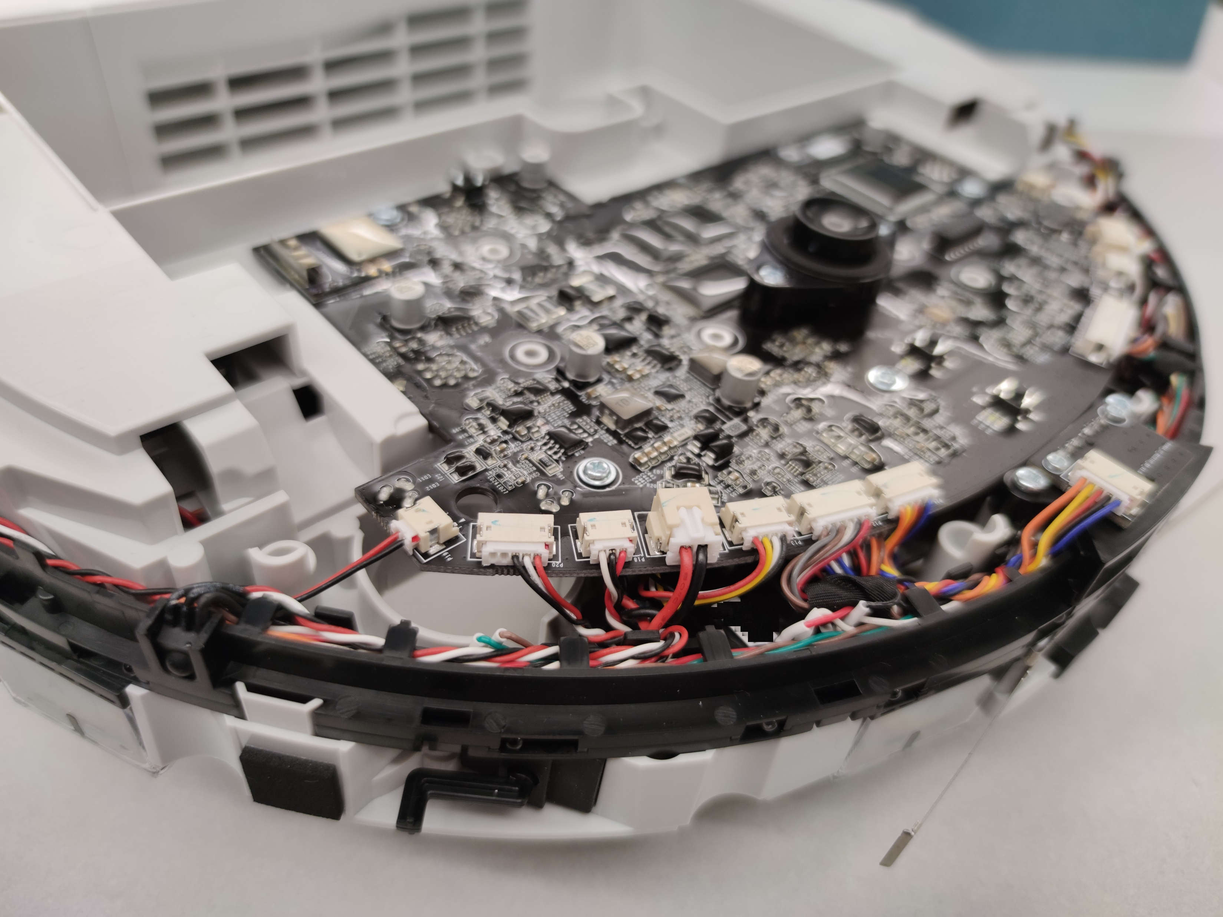
Dreame 1C/F9/D9 technical information and rooting:
Get control over your vacuum robot
Notes:
Welcome to the rooting how-to of the Roborock S6 and T6 model. Here I will show you how to get control over your vacuum robot

Slide 2
Before you continue: Please watch the whole video before you start your adventure
All commands and links are in the description
You might want to join the Telegram group
Notes:
Before we start a few comments. Please watch the whole video before you start your adventure. If you don’t have a technical background, you might be overwhelmed with this.
All the commands we use here are linked in the description. You can copy and paste them from the cheatsheet.

Slide 3
Good news: No soldering or teardown required

Slide 4
Why get root access?
Use Valetudo (https://valetudo.cloud/)
Replace the cloud functionality with an open-source software
Integrate the device into your home automation
Install your own soundfiles/voices
Notes:
Ok, lets talk why do we want to get root access in the first place.
Many users purchased their robot as the T6 model, which is geo-blocked outside of Mainland china. With root access you can remove this geo-blocking.
Probably the most important reason is to use the Valetudo software, which replaces the cloud functionality with open source software. This also enables you to integrate the device in your home automation software.
Also we can install our own soundfiles and voices.

Slide 5
Risks
A failed flash can leave the device in an undefined state
Requires reflashing
Problem:
All partitions need to be recreated
Device identity (Device ID, Cloud keys, MAC) gets lost
Calibration data lost
Observations:
Device identity does not matter if you use Valetudo
Unknown consequences for lost calibration data

Slide 6
Risks
Experiences so far:
>10 successfully rooted robots using „optimized“ method
1 erased device (Dennis‘s 1T) without backups
Lost calibration and device identity
Assumption: wrong software and connection issues
1 erased device (Sören‘s D9) with a backup
Some data lost, but we had backups due to a prior root
Assumption: wrong software and connection issues
1 fried device (Dennis‘s 1T) with magic blue smoke
Mainboard damaged due mixing of VCC (5V) and GND
First iteration of custom board
Takeaway lession: double check your cables!!!

Slide 7
More risks
Problem: Hardware differs even for the same „model“
The root method cannot verify your exact model
Flashing an incorrect firmware will perma-damage your device
Other, not obvious side effects might occur
Recovery might be tricky and can cause problems
Important: Make sure that you have the correct firmware
Do not try to use the same generated firmware on multiple devices
If you are unsure, ask us first!

Slide 8
Sidenotes
Rooting will permanently change files on your device*
Cloud connection / App usage should be still possible
By installing a custom firmware, you cannot update your device with official firmwares anymore
That is the price of rooting
You can update your device with custom firmwares
Use USB2 connections whenever possible
Connect to your robot and write down the MAC address
* we needed to reconstruct parts from the firmware by extracting contents from flash and guessing unknown parts.

Slide 9
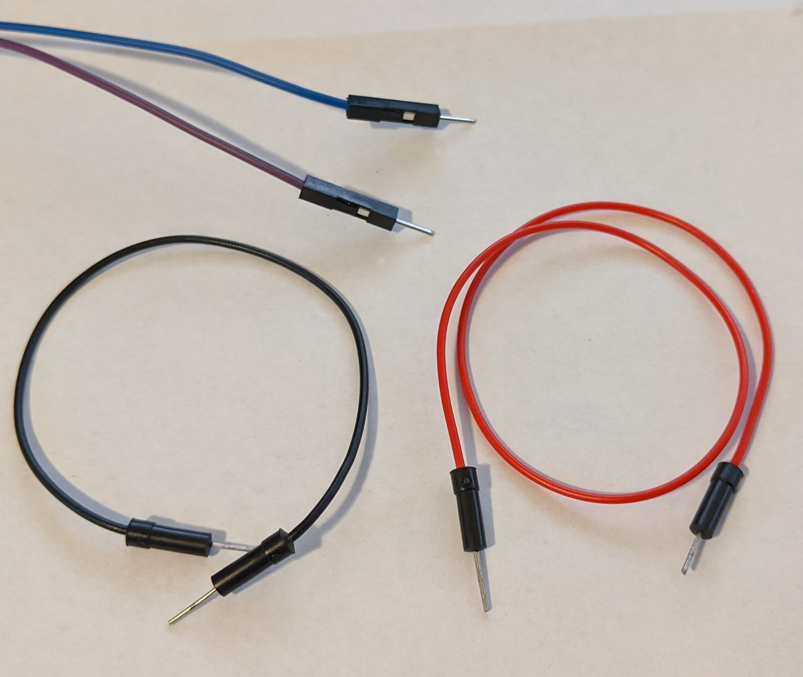
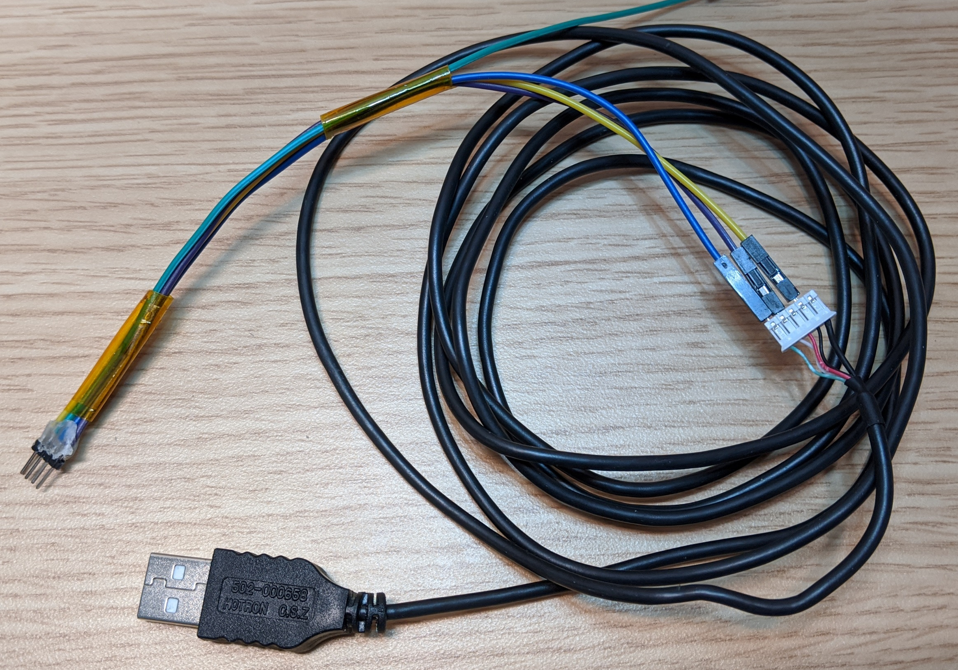
Tools required for root
Breadboard Jumper Wires
2mm pitch headers
USB cable
(e.g. from a broken USB mouse)
Alternative: custom PCBs
Notes:
To root the devices we need a few tools. We need screwdrivers to disassemble the device. I created a step by step video about how to do that. Its linked in the description.
Also we need a UART to USB adapter. You might find them under various names, like serial adapters or TTL adapters. The important thing here is that they support 3.3V logic level. Usually you can get them very cheaply over amazon or even in local stores.
For the actual connection, we need a few thing isolated copper wires or some breadboard jumper wires. Also some tape might be helpful.

Slide 10
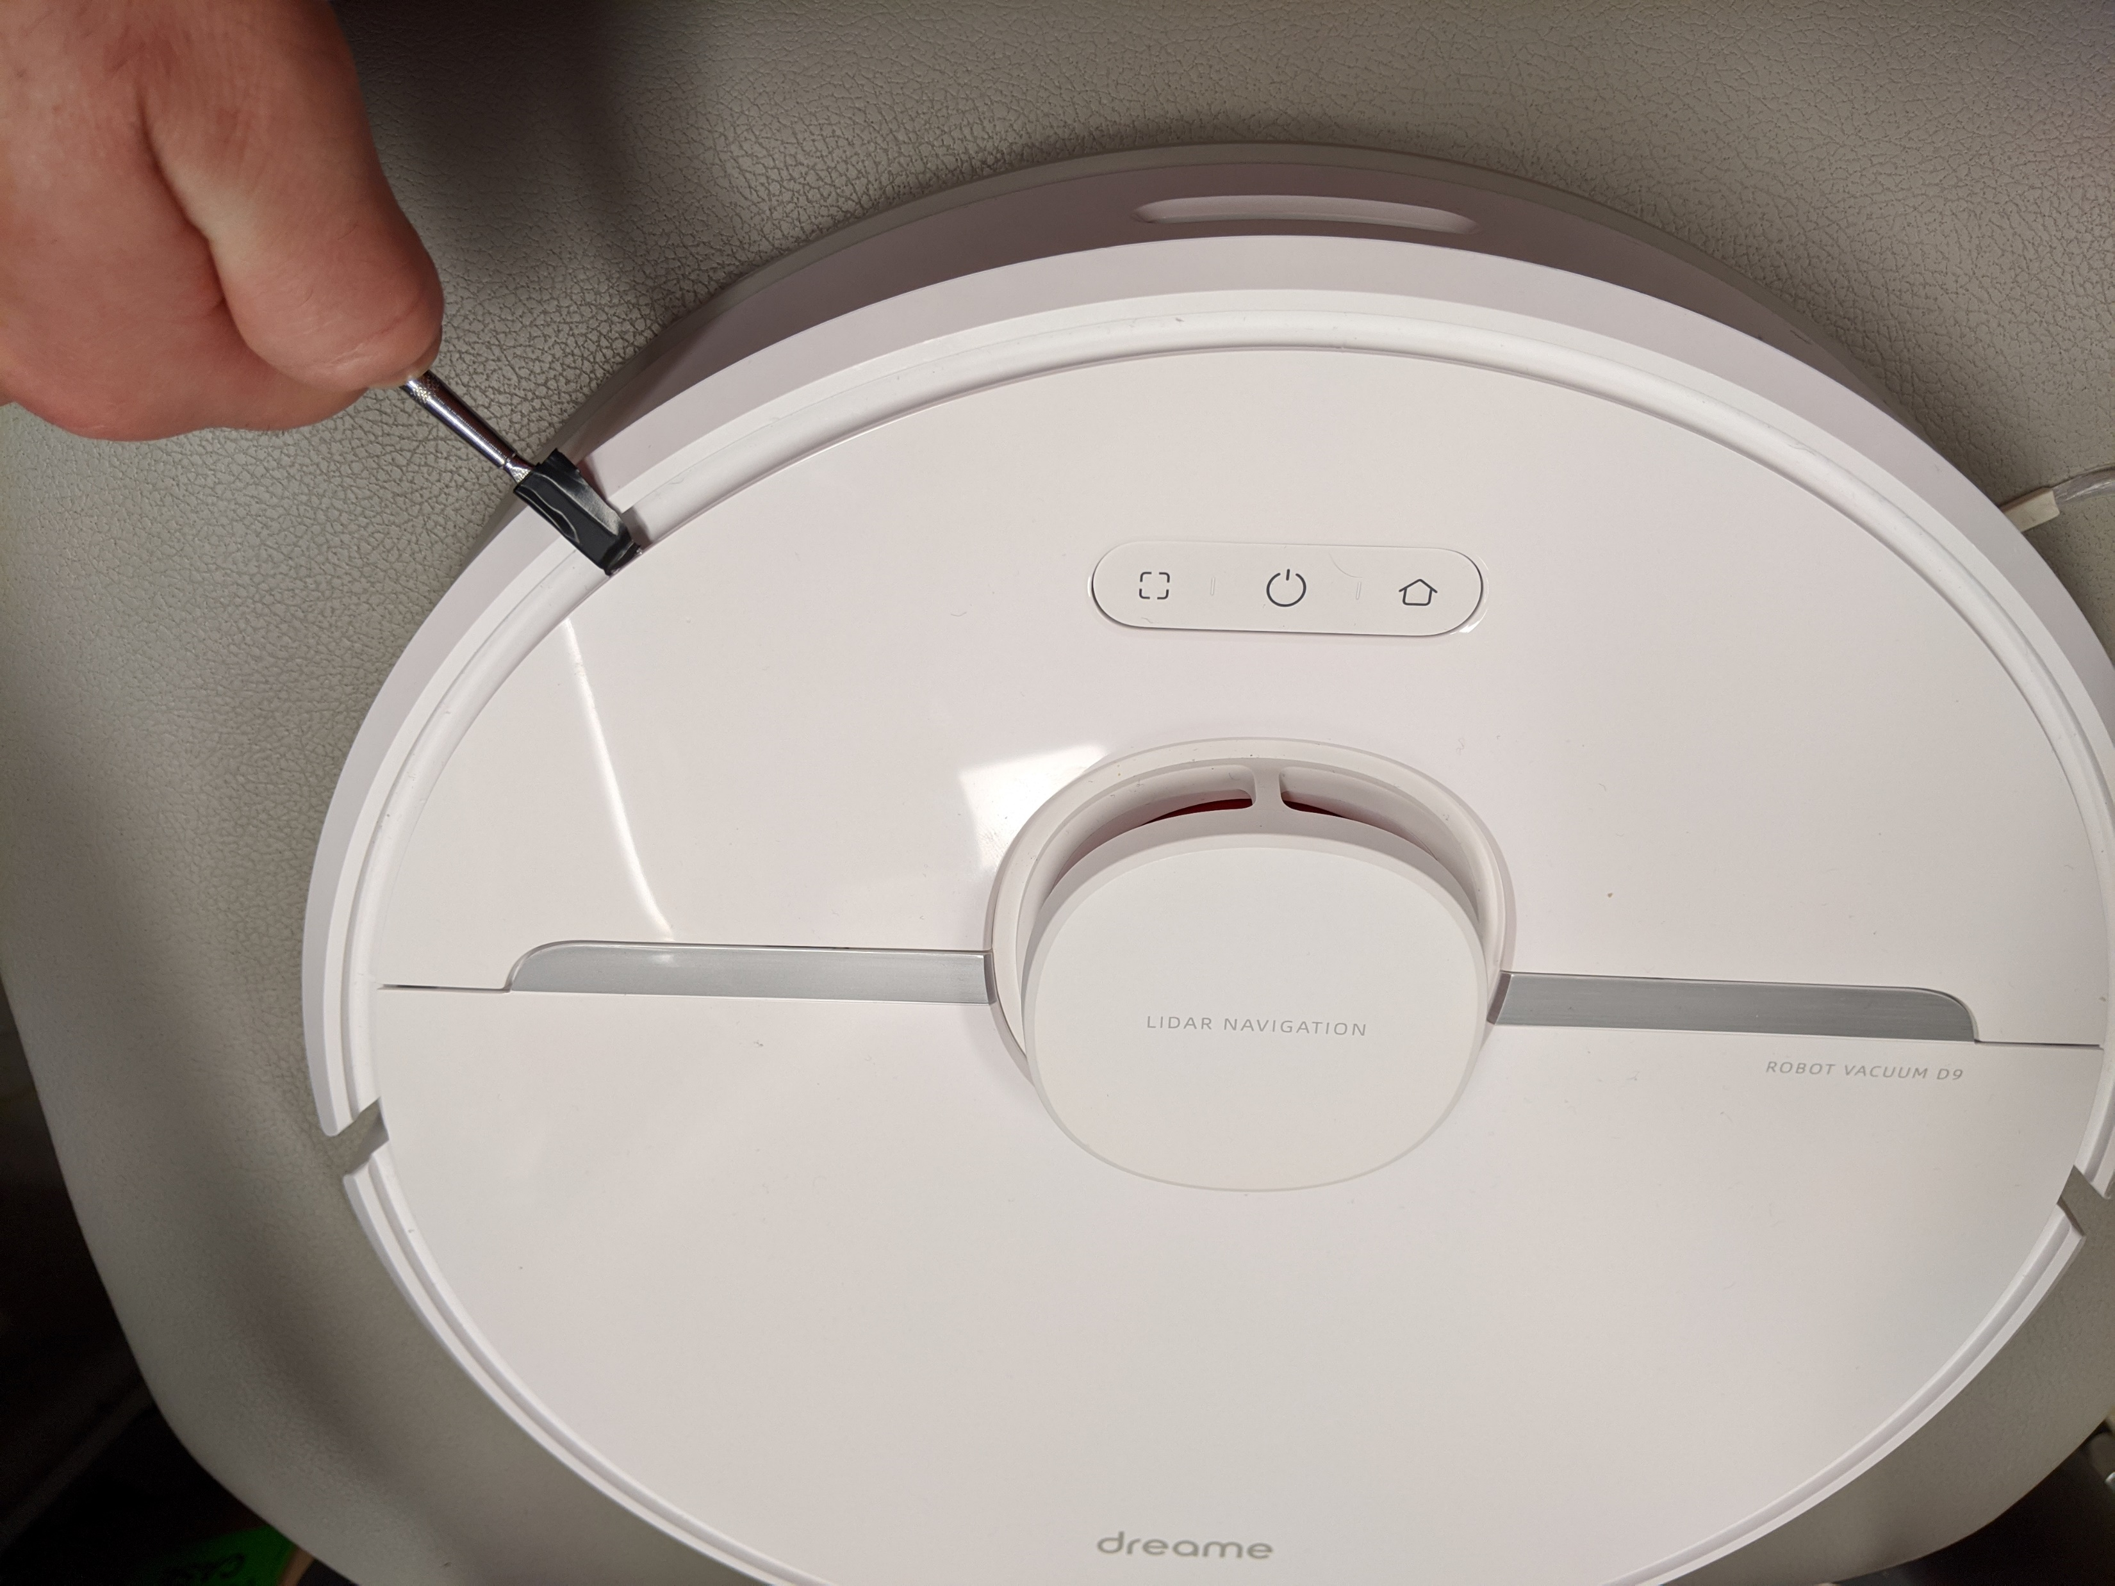
Opening the device

Slide 11
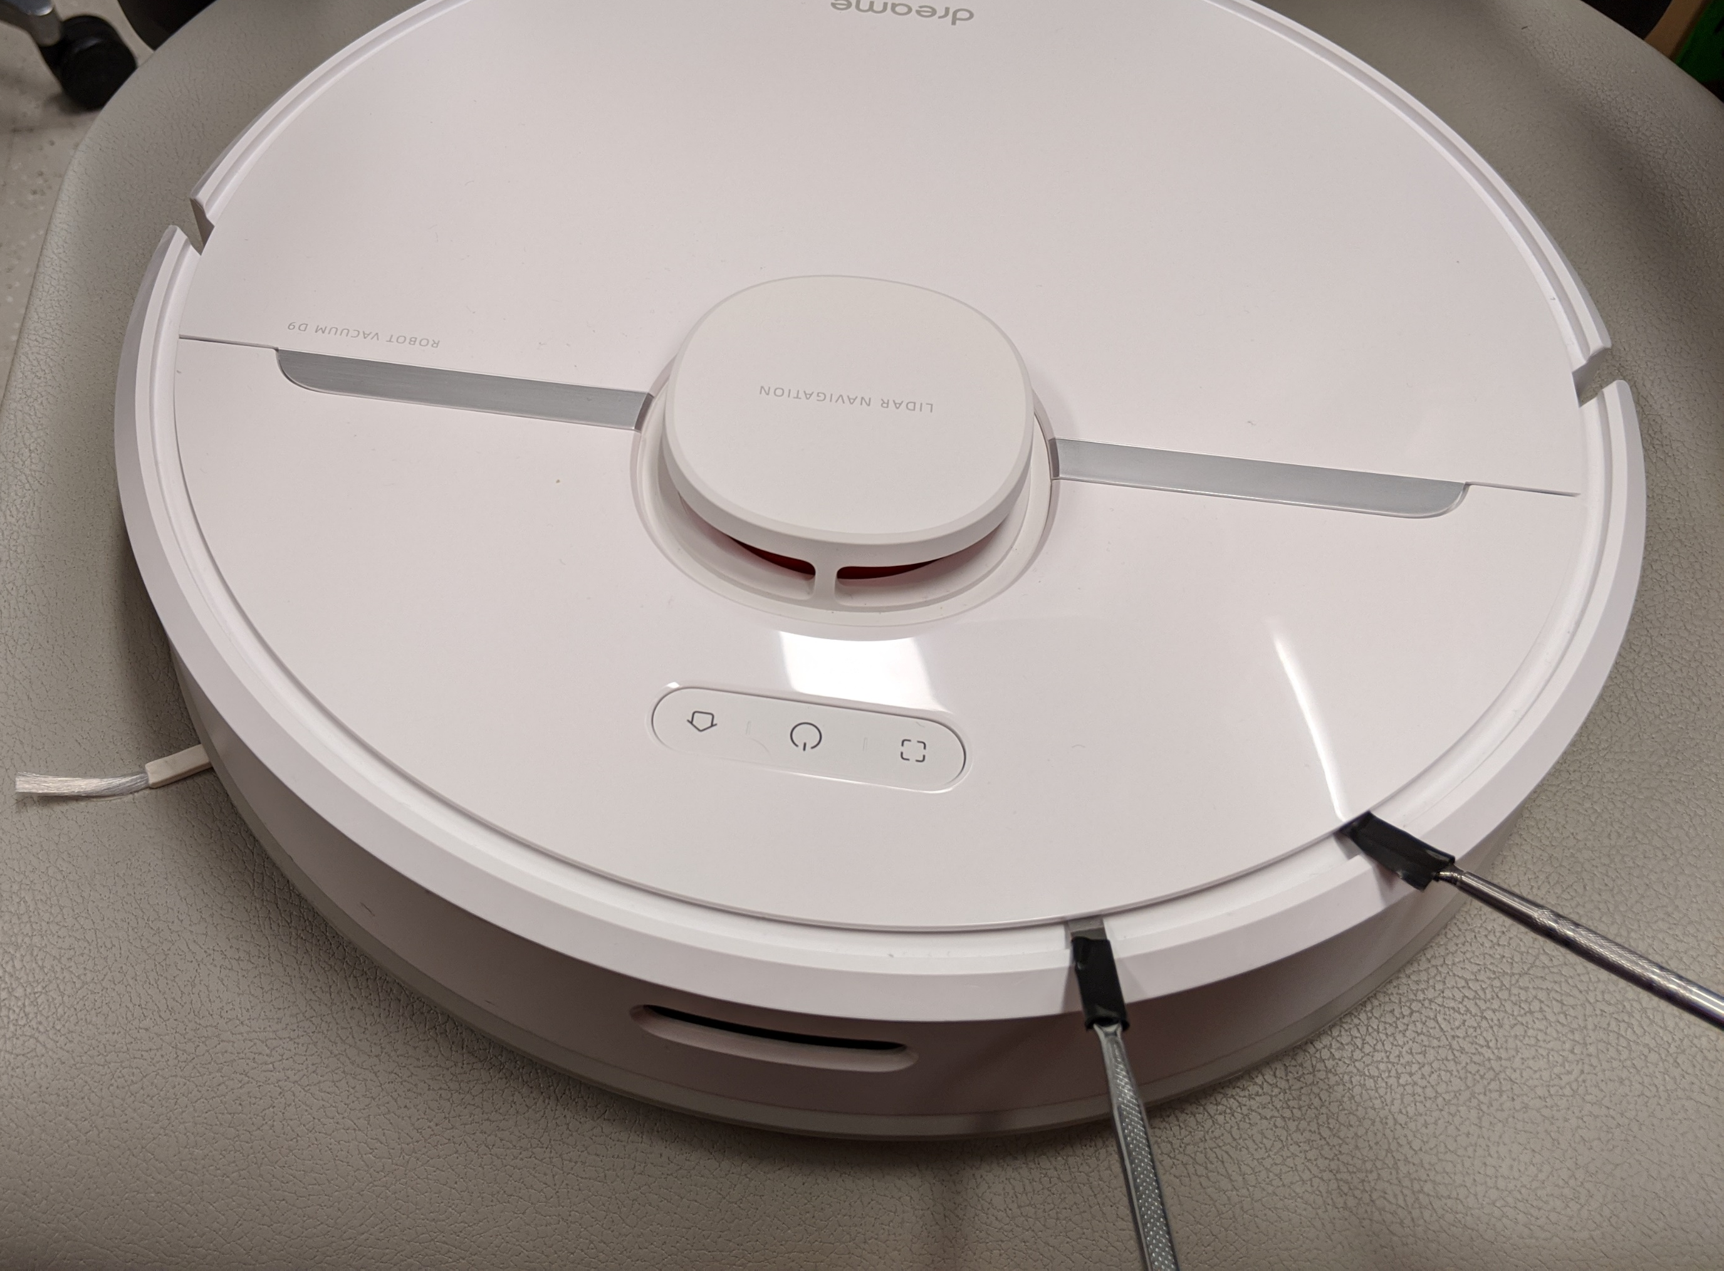
Opening the device

Slide 12
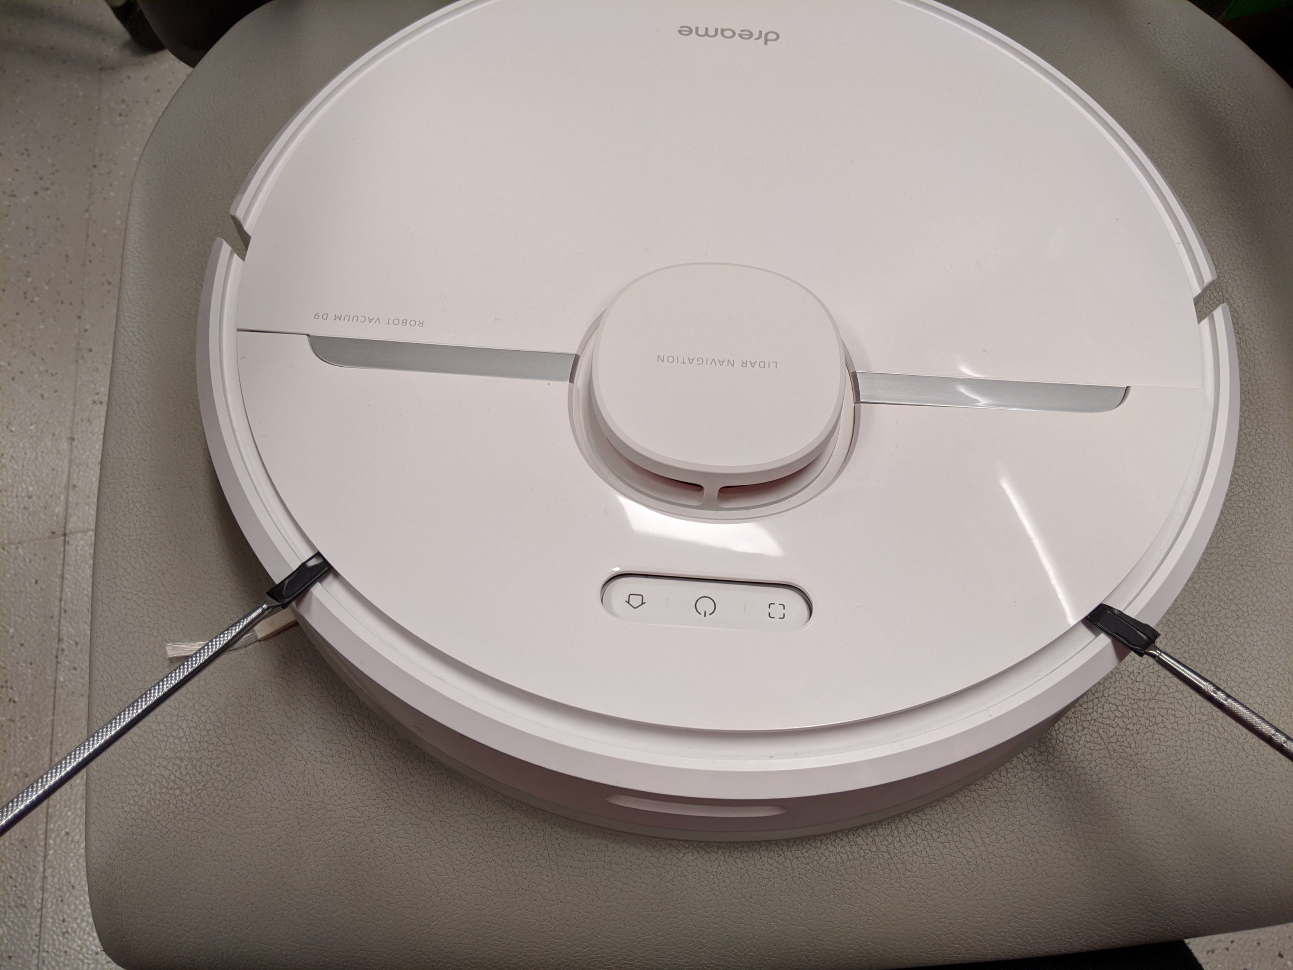
Opening the device

Slide 13
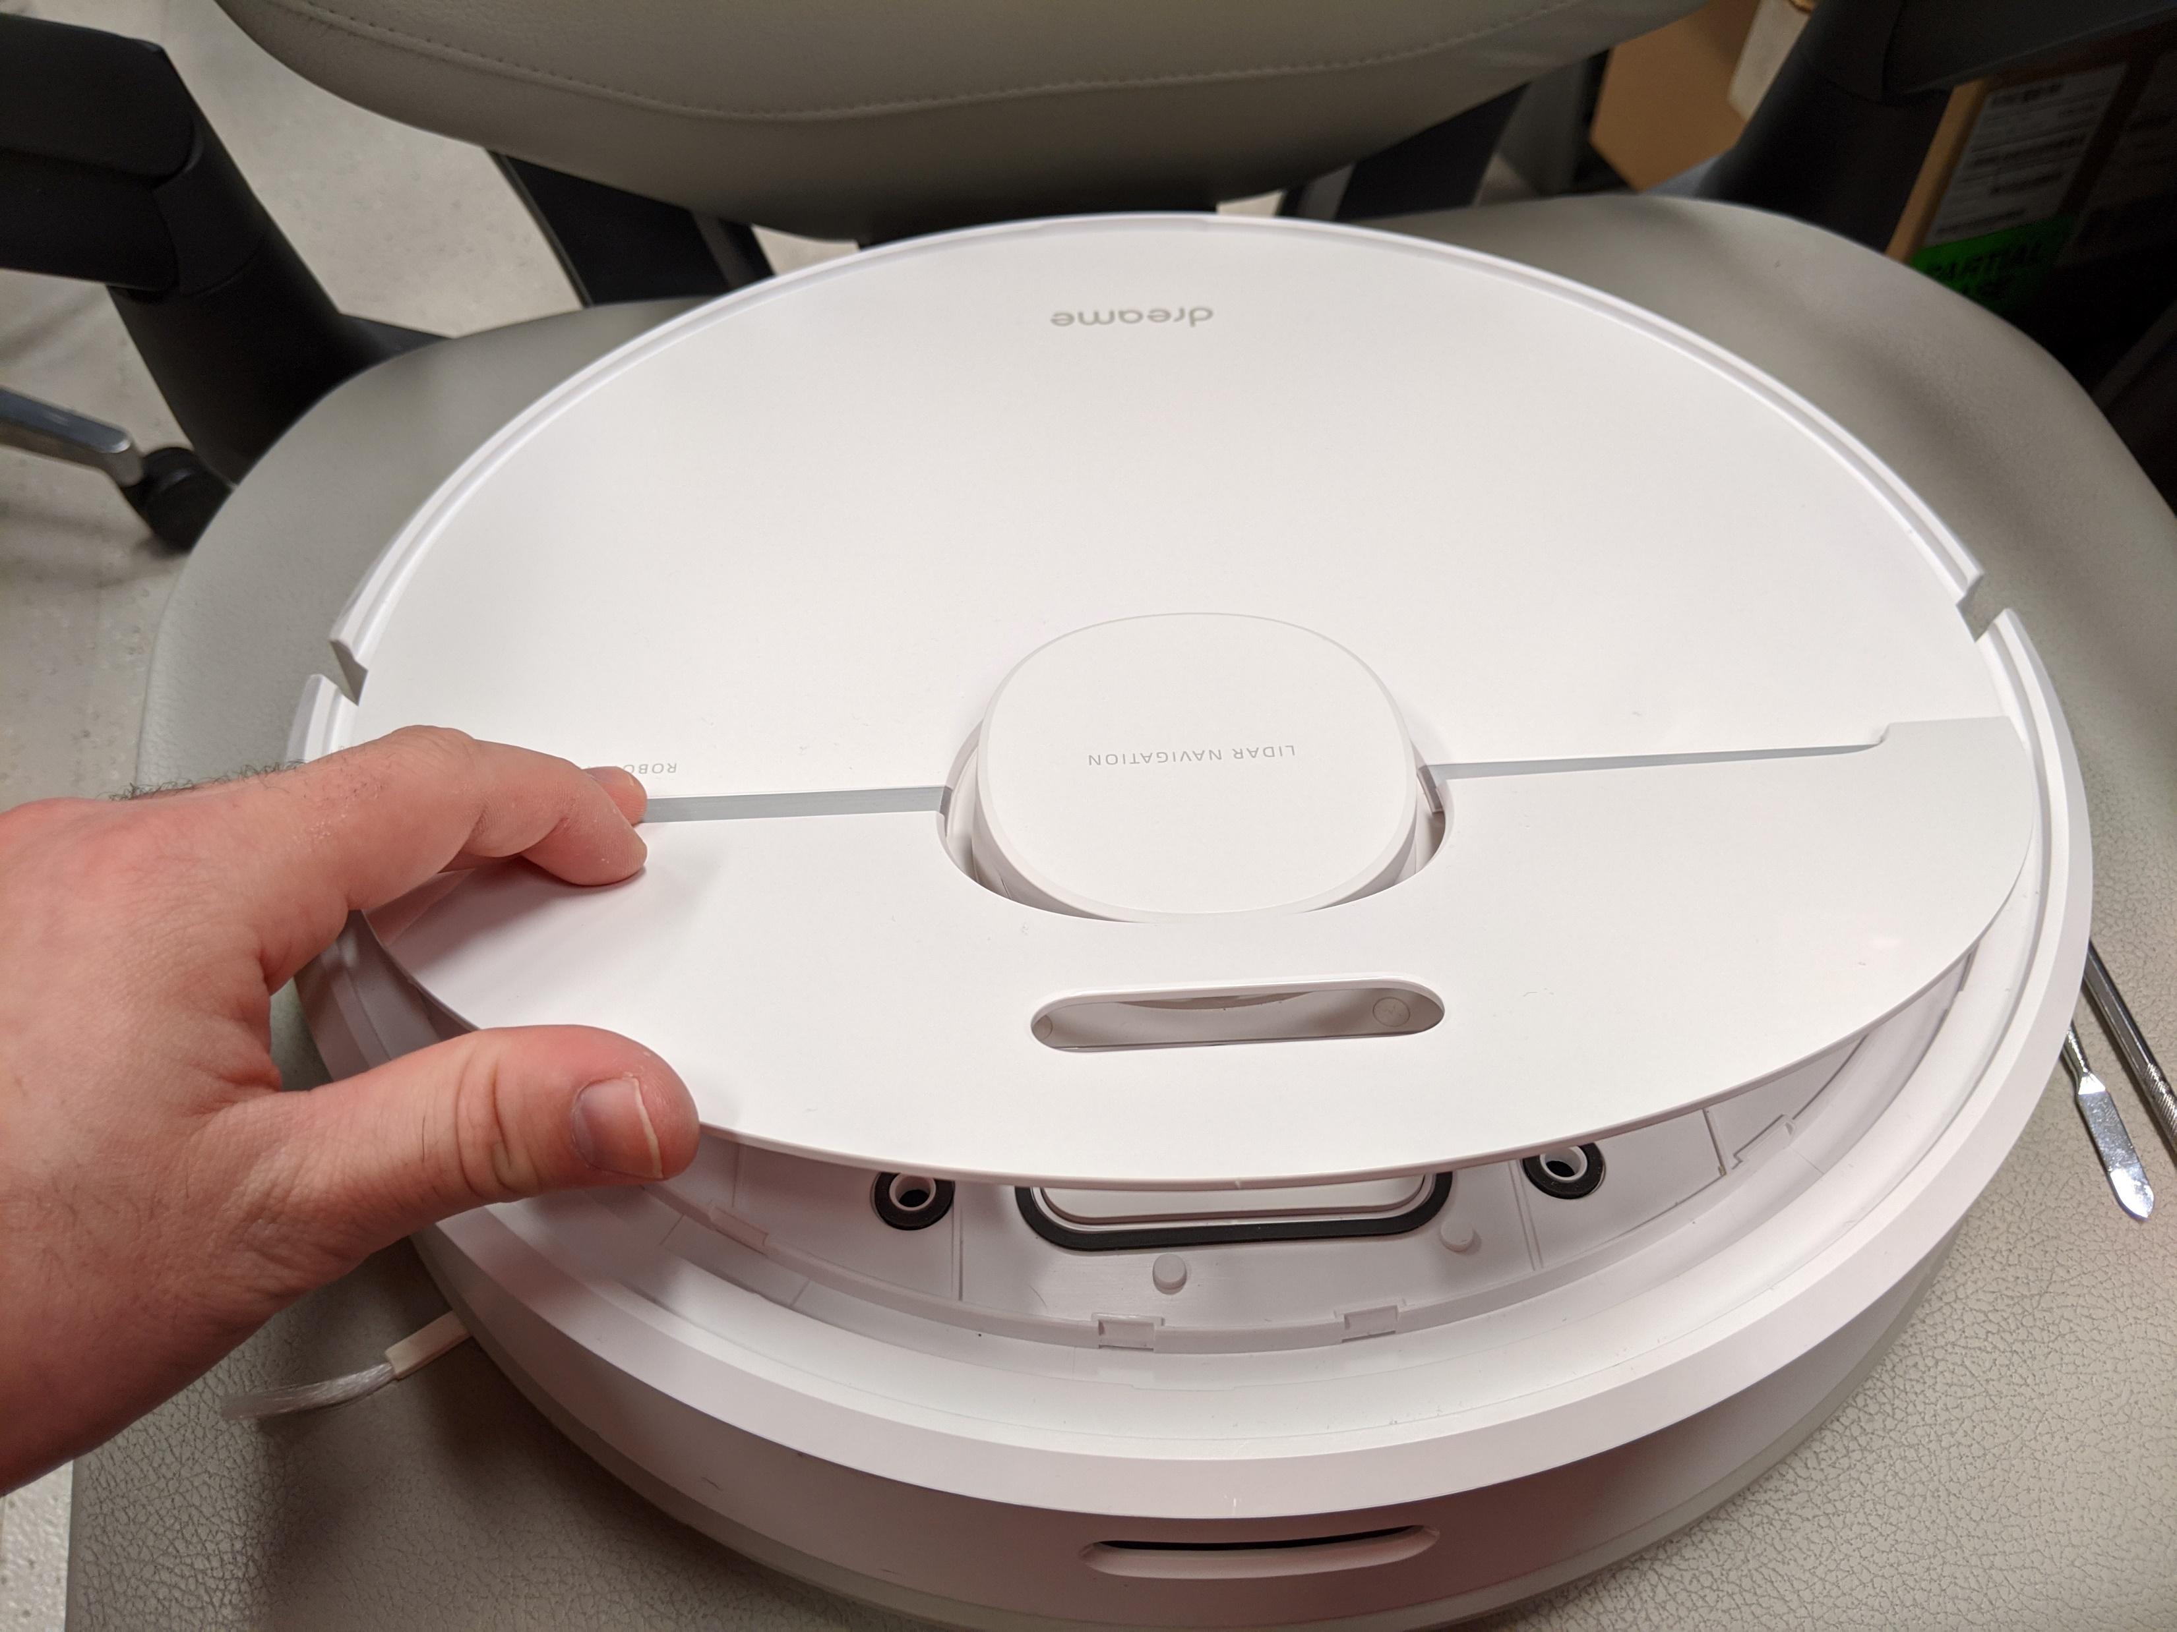
Opening the device

Slide 14
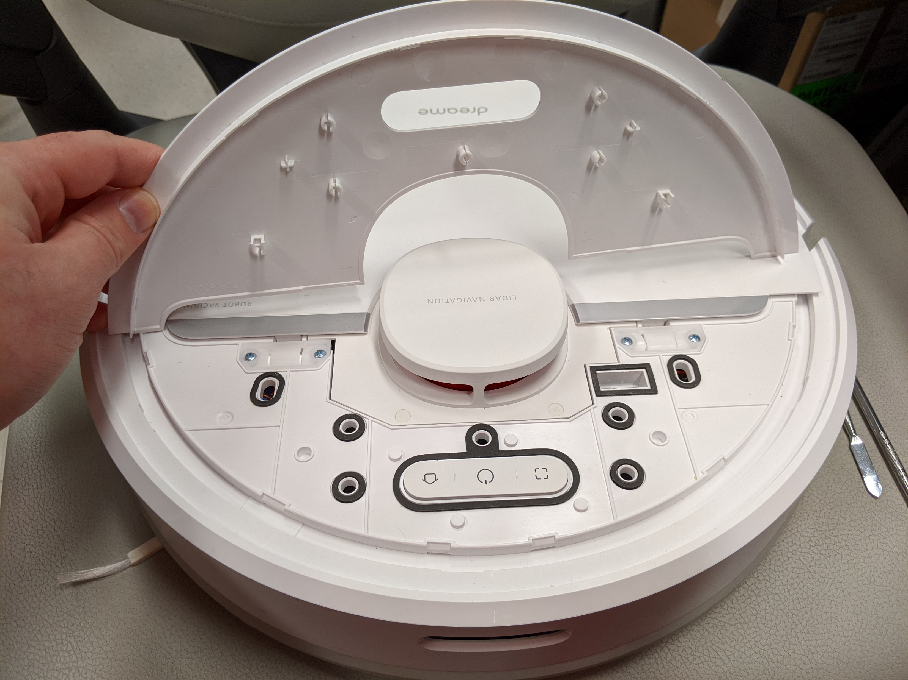
Opening the device

Slide 15
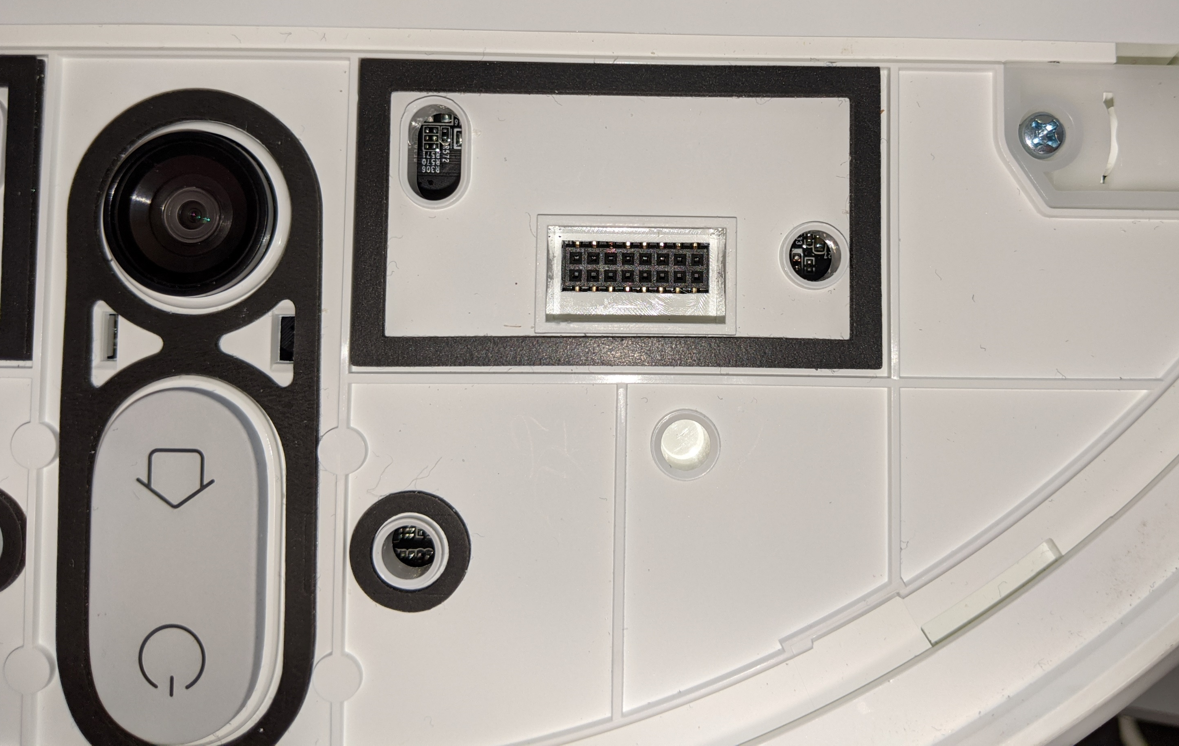
Debug pinout
Debuginterface
2x8 pins
2mm pitch size
Dontvacuum.me
GND
Warning:
2mm pitch size is way smaller
than the usual 2.54 mm
VBUS
(Do not connect)
Boot_SEL
Warning:
Make sure you connect to the
correct pins!
RX
TX
D+
D-
Front

Slide 16
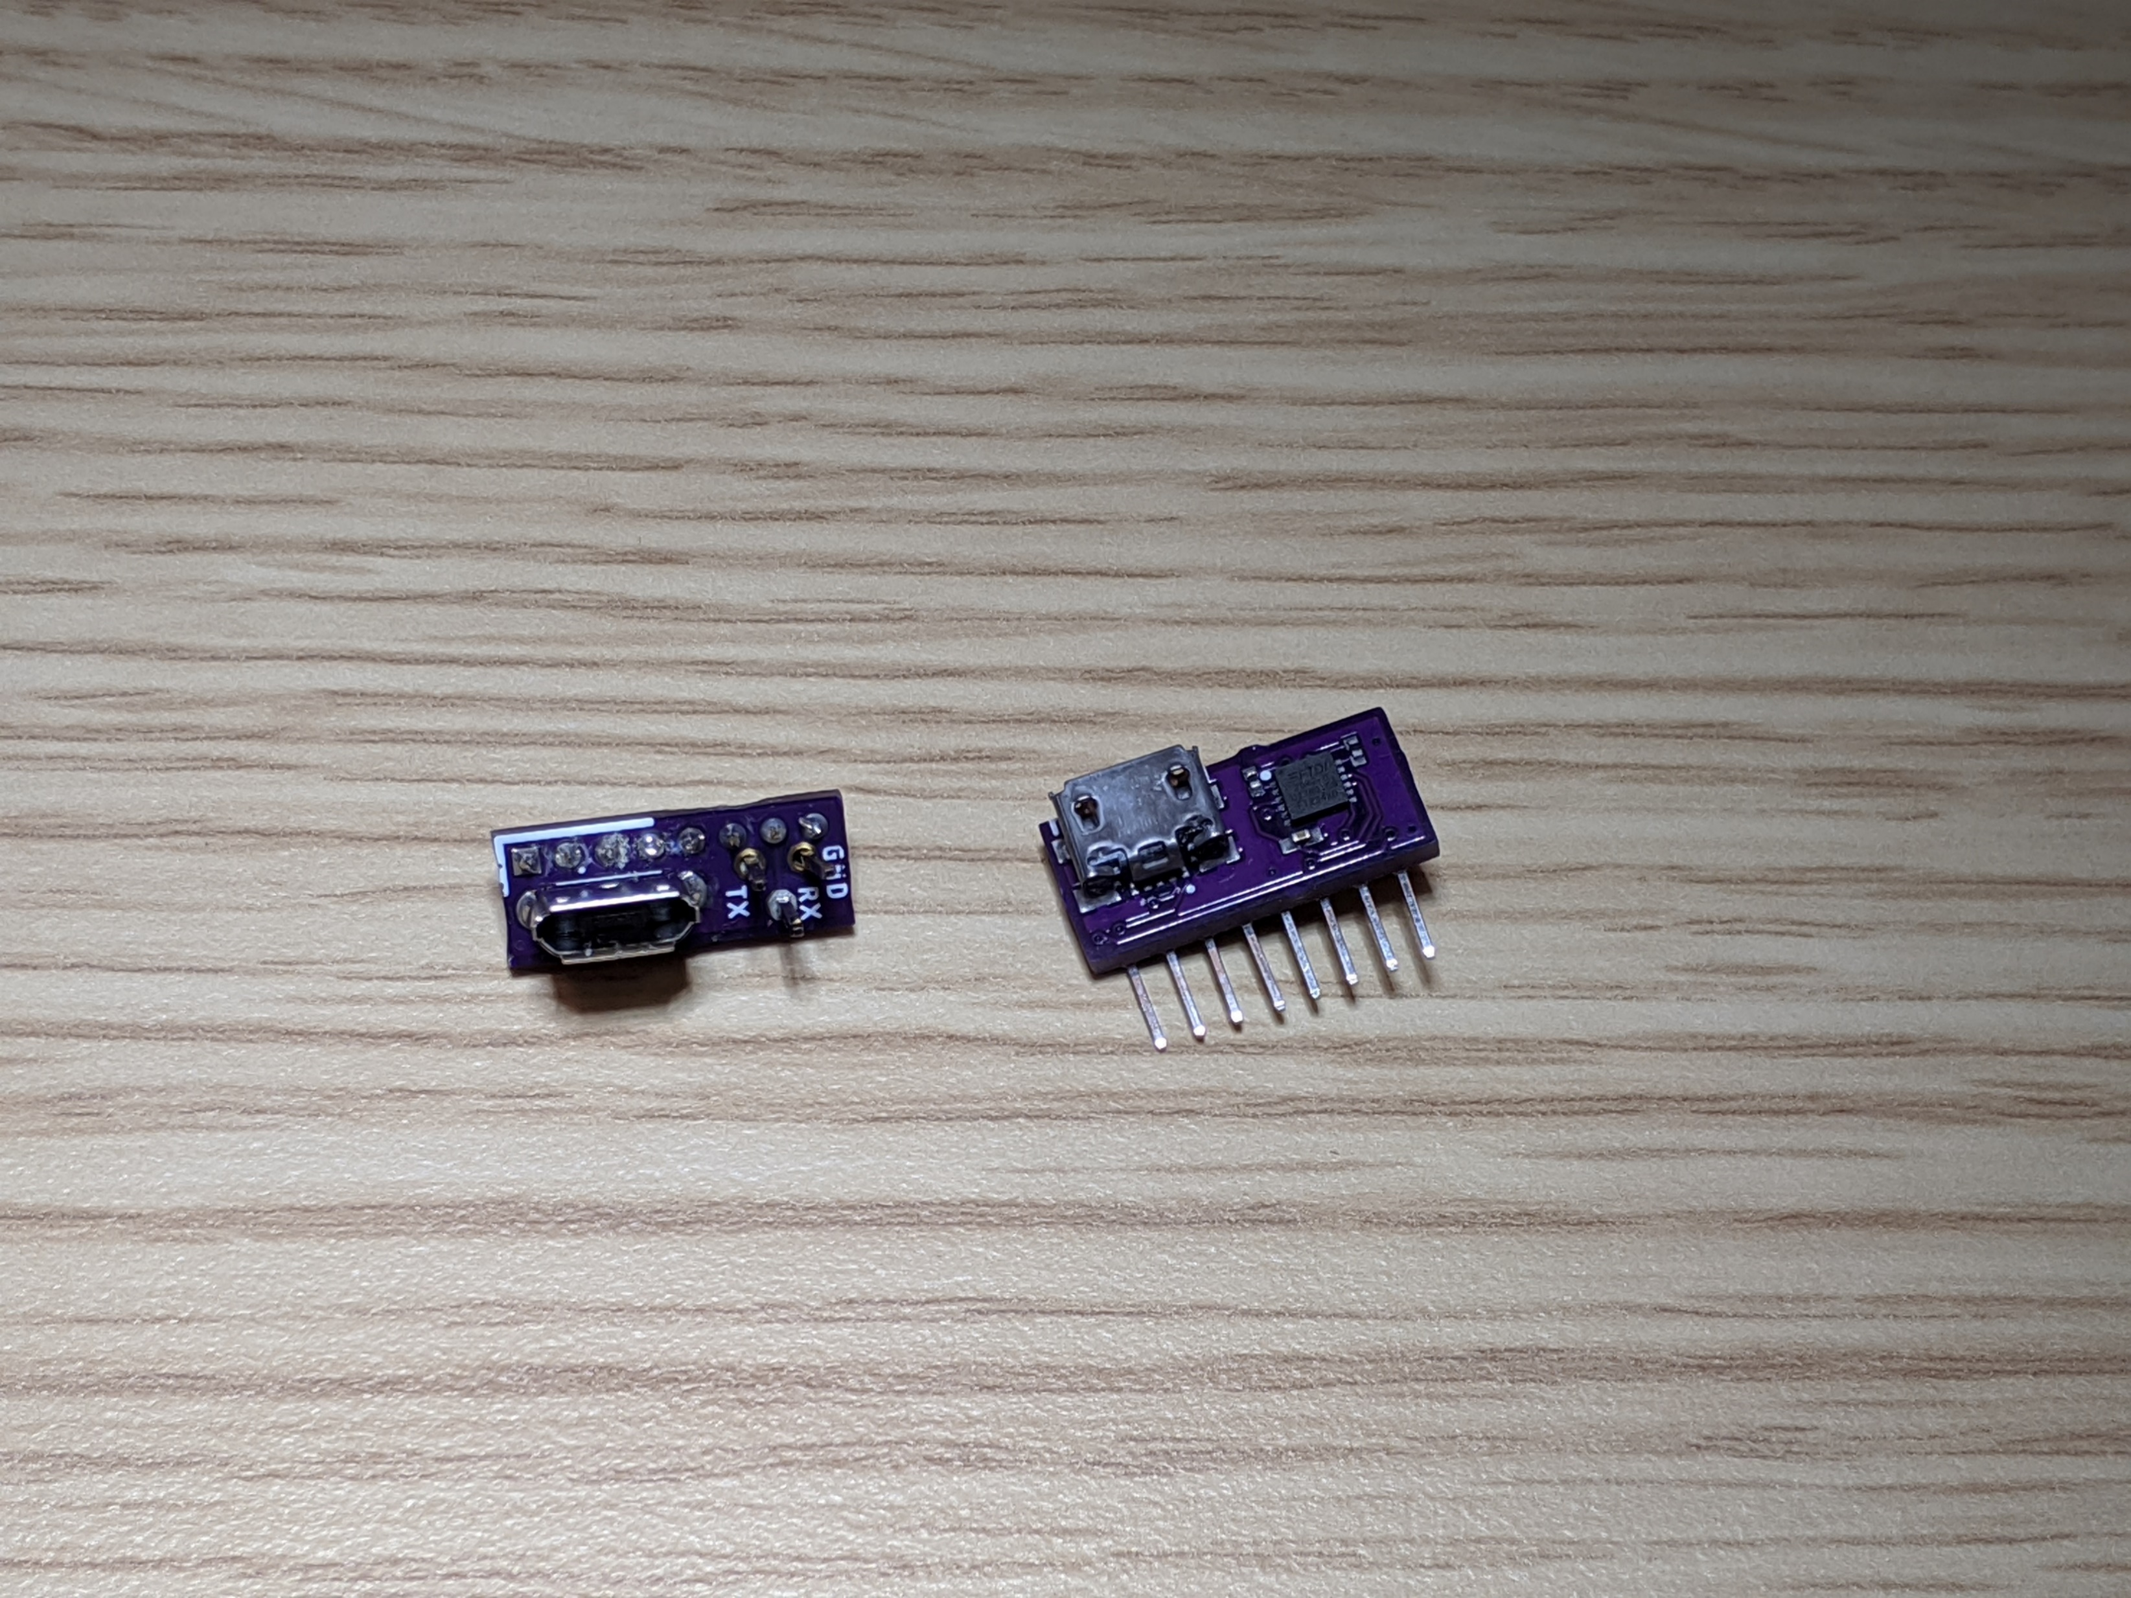
Rooting with custom PCBs
USB + UART headers
(aka basic PCB)
USB + integrated UART
Adapter
(aka Advanced PCB)
Check builder.dontvacuum.me/dreameadapter for the Gerber files

Slide 17
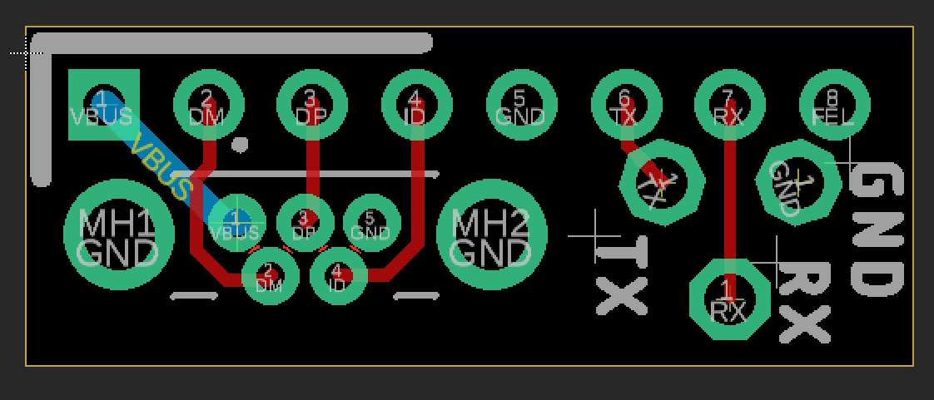
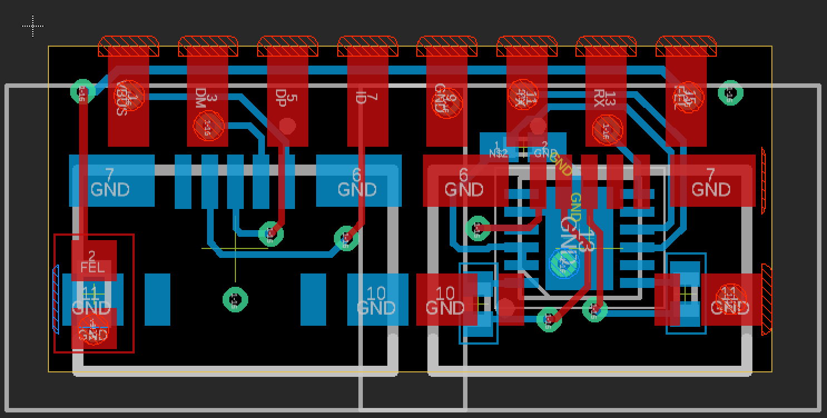
Rooting with custom PCBs
USB + UART headers
(aka basic PCB)
USB + integrated UART
Adapter
(aka Advanced PCB)
Check builder.dontvacuum.me/dreameadapter for the Gerber files

Slide 18
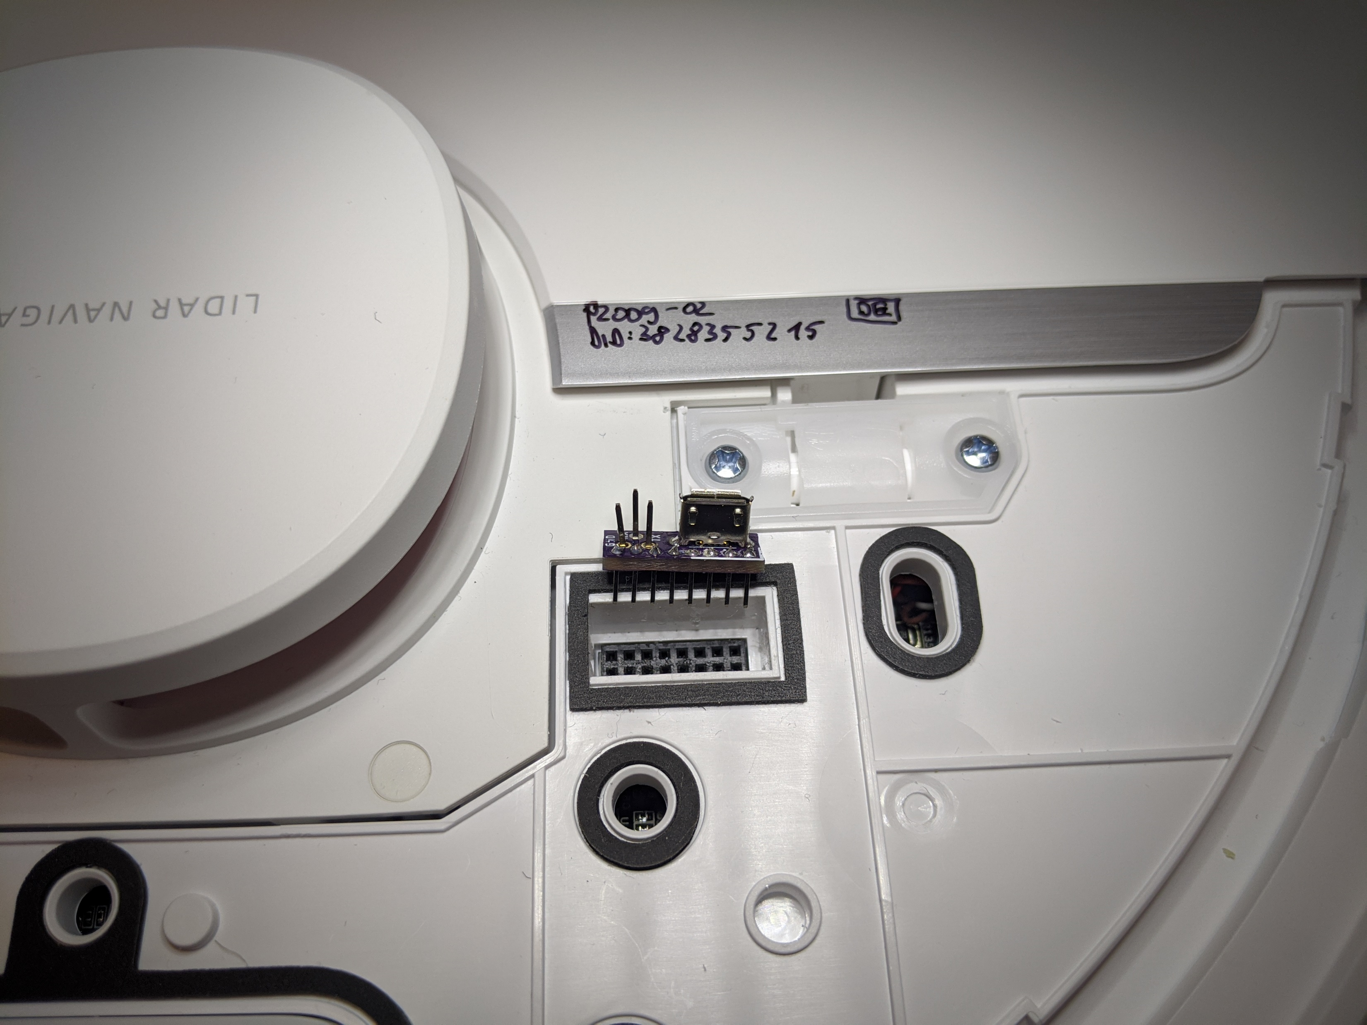
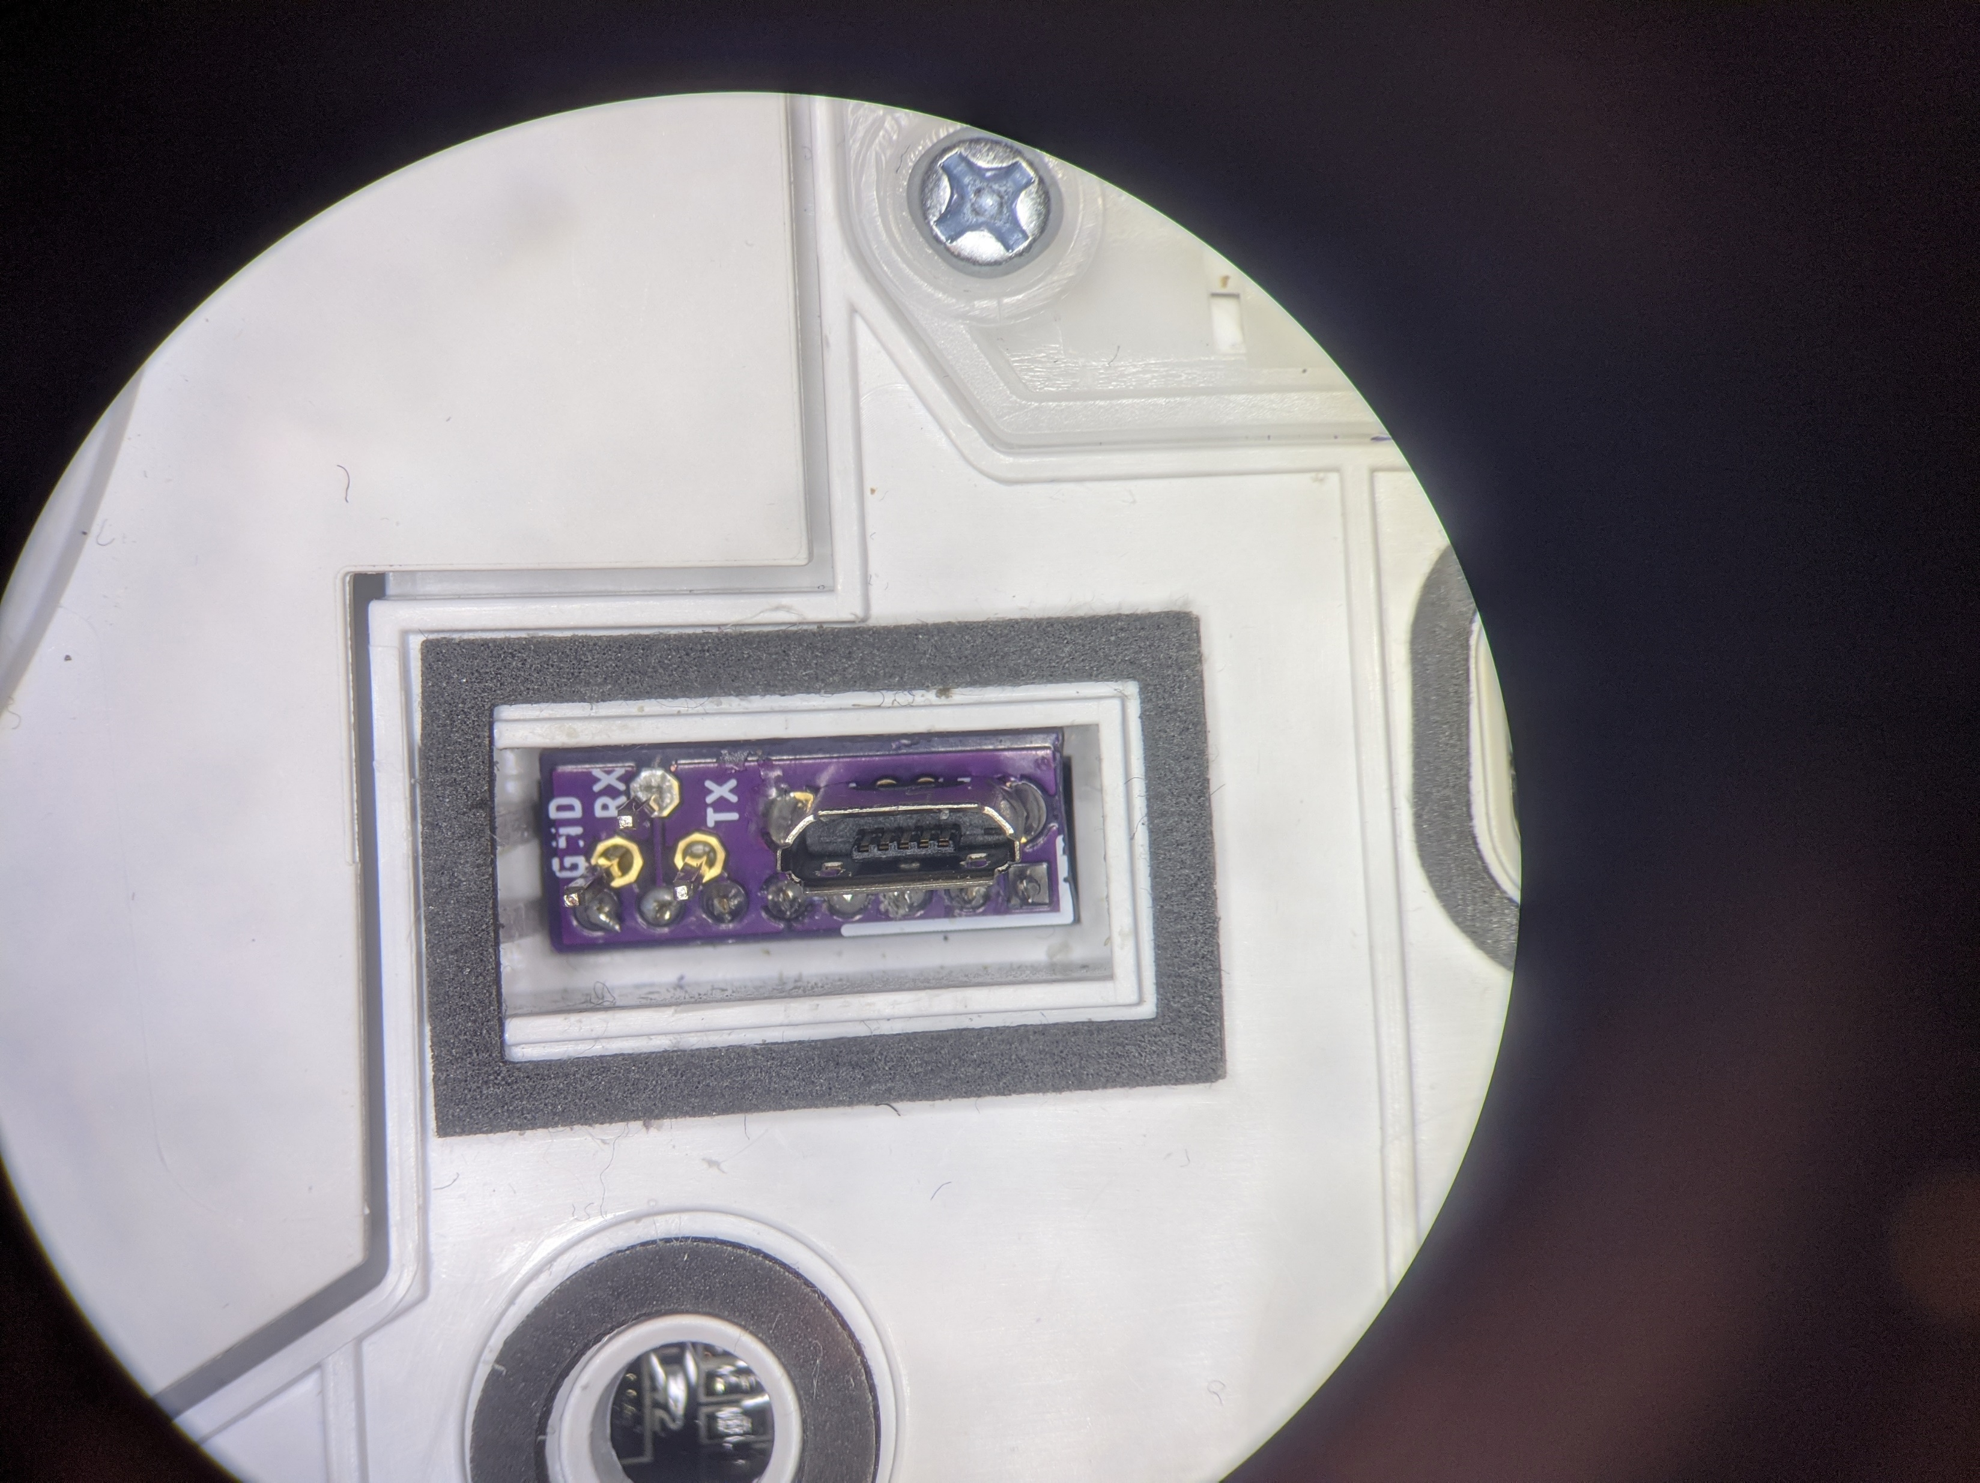
Usage of basic PCB
UART
USB
Marker
(front, right)
BOOT_SEL
Front
Front

Slide 19
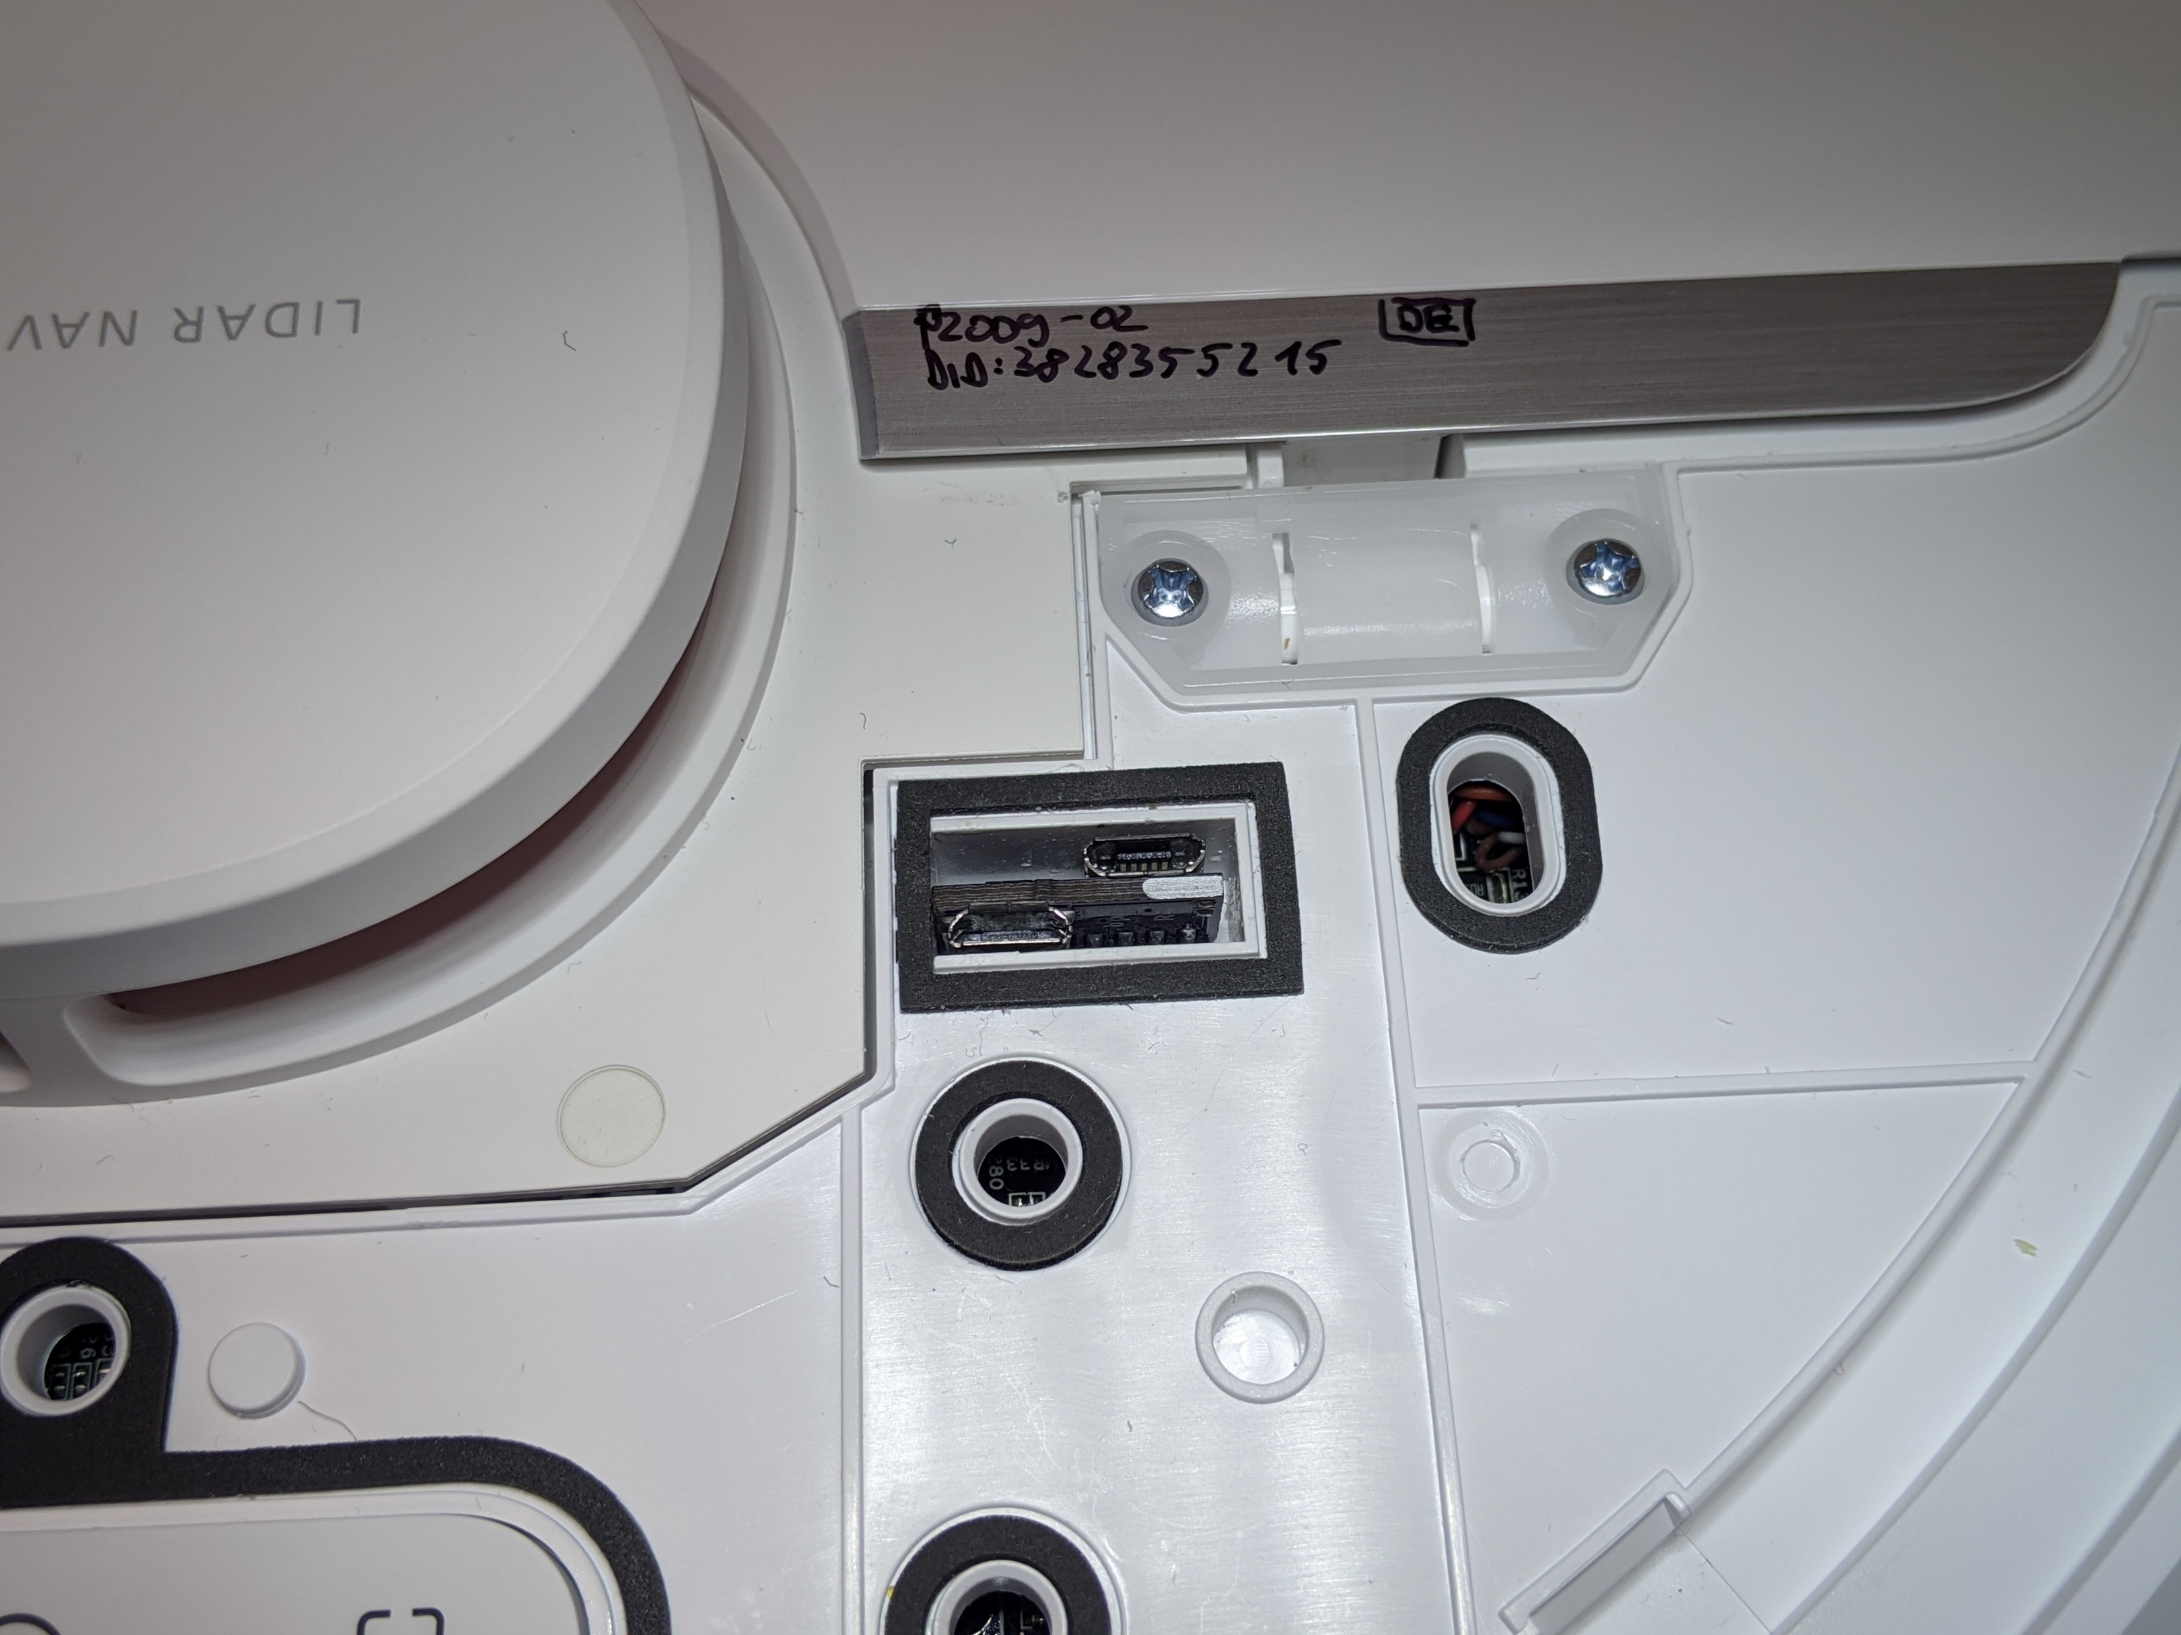
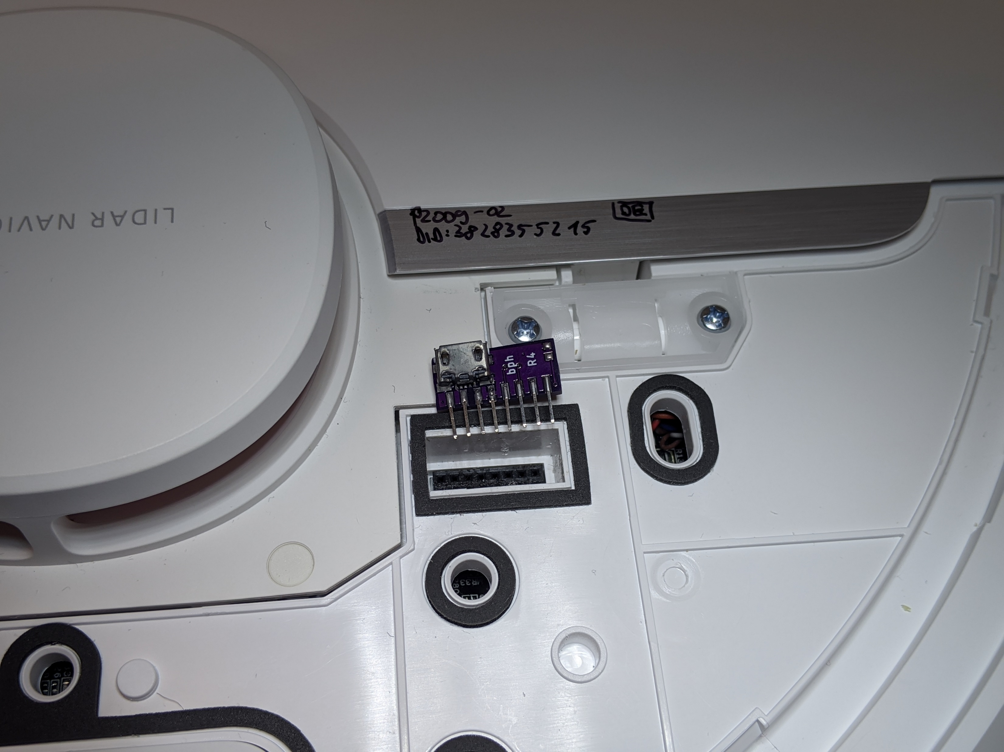
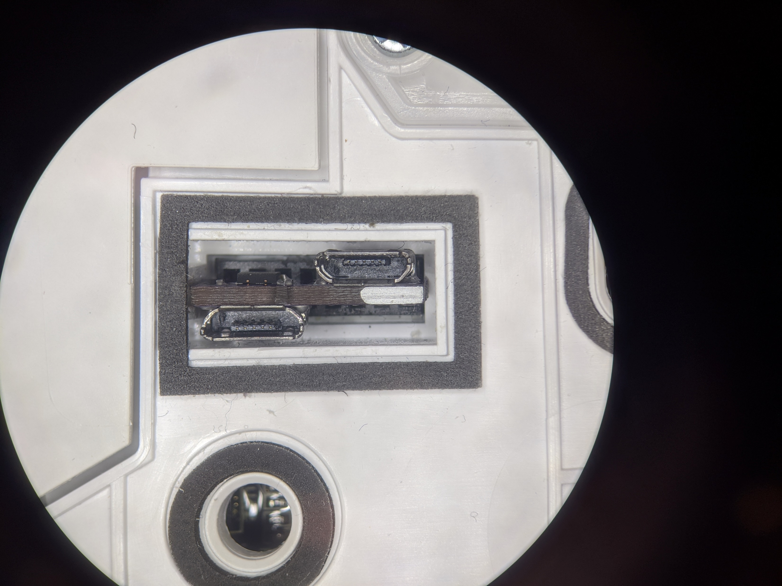
Usage of advanced PCB
USB
Marker
(needs to be on the right)
UART
BOOT_SEL
USB
Front
Front
UART
BOOT_SEL

Slide 20
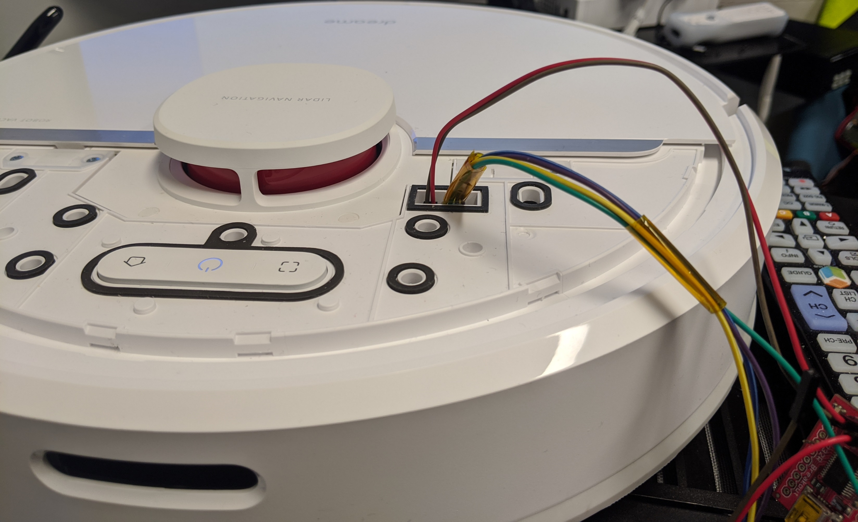
Connecting jumper wires (2mm pitch)

Slide 21
Backup of configuration and calibration
Background: If flashing the custom firmware fails, the robot might delete the configuration and calibration files
Idea: Interrupt U-Boot, boot in single user mode, backup files
Limitation: works only on 1C/F9/D9
Power off the robot
Connect to UART (115200 baud, no flow control)
Power on the robot and keep key “s” pressed
Modify the command line and boot
Print files over UART

Slide 22
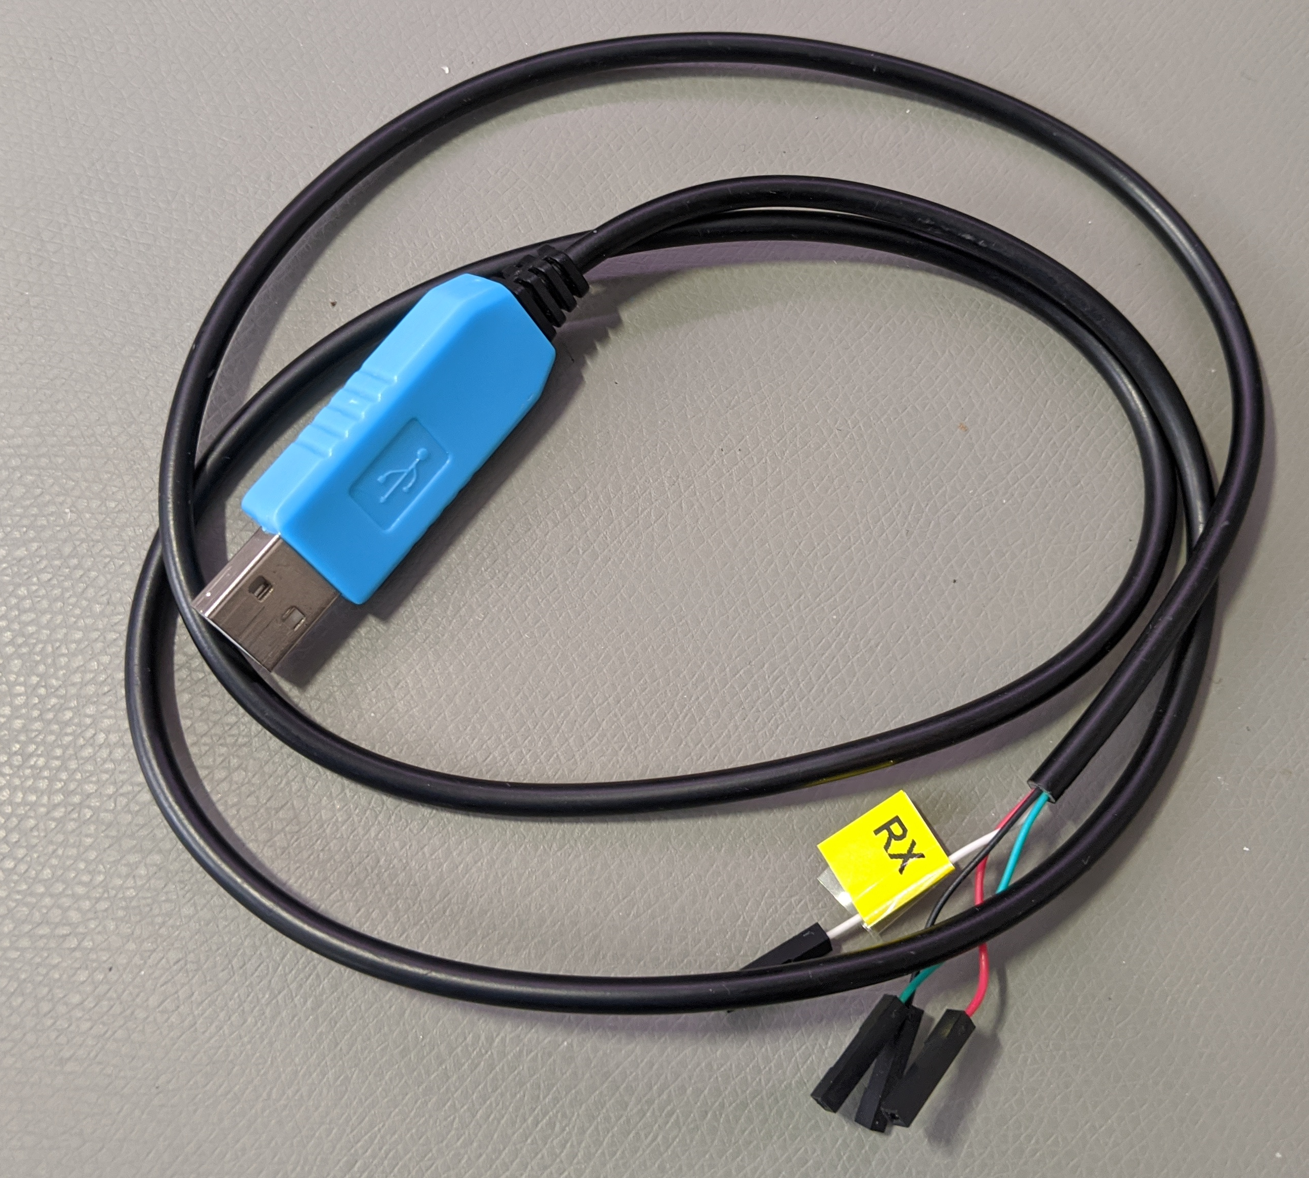
Backup Step 1
Get an adapter
Reminder: Works only on 1C/F9/D9
UART-USB adapter (3.3V, aka TTL adapter)
Typical chipsets:
FT232RL, FT232, PL2303TA or CP2102
Price ~10 USD/Euro
Notes:
To root the devices we need a few tools. We need screwdrivers to disassemble the device. I created a step by step video about how to do that. Its linked in the description.
Also we need a UART to USB adapter. You might find them under various names, like serial adapters or TTL adapters. The important thing here is that they support 3.3V logic level. Usually you can get them very cheaply over amazon or even in local stores.
For the actual connection, we need a few thing isolated copper wires or some breadboard jumper wires. Also some tape might be helpful.

Slide 23
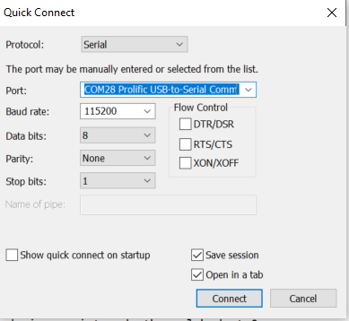
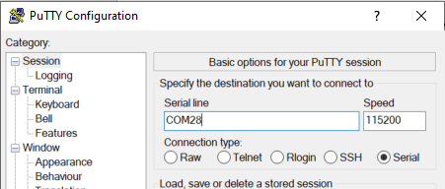
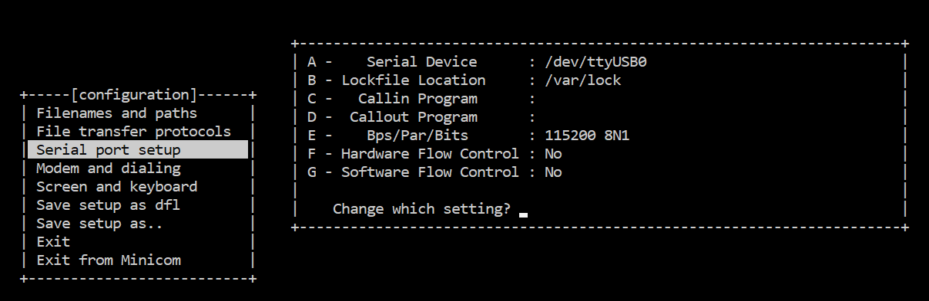
Backup Step 2a
Know where RX and TX on your adapter is
Configure your UART program
Baud: 115200
Flow control: off (!)
Test the settings without robot
Notes:
In this step, we want to setup your computer for the serial connection. You need to know where the RX and TX on your adapter is. For some adapters its marked, for some it’s a particular color of cable. In my case white was RX and green was TX. But don’t worry, you cant damage your robot, if you have it wrong.
Set your UART program to 115200 baud and disable flow control. This is very important. I have shown here a few example programs. Finally you want to test your settings. If you connect TX and RX of your adapter together and then type something, you should see an echo. This is what we call loopback.

Slide 24
Backup Step 2b
Connect serial wires to PCB
Do not connect 5V (red cable)!
Test for correct connection
Press middle button (<1s)
You should see some output
Notes:
In the next step, we connect to the robot. First, we need to connect the battery to the PCB. There is only one way to connect it, so you should not be able to do it wrong.
Then we connect the serial wires to the PCB. As mentioned before, you can use a MicroUSB cable to get ground. Connect TX and RX. Do not connect the red cable which is 5V. This is very important.
As a first test, that you did everything correctly, press the power button less than one second. It’s the middle button on the PCB. If you do that, you should see some text output from your robot. If you don’t see anything, then you might have mixed RX and TX or your connection is bad. If you see some cryptic text, your settings might be incorrect.

Slide 25
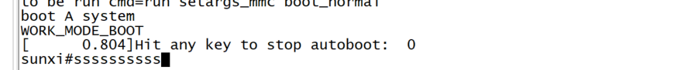
Backup Step 3
Inside the terminal program
Hold “s” key on your keyboard
At the same time: Press middle button for 3 seconds
We want to see this:
Notes:
Now comes the important part. Press and hold the S key on your computer. Then at the same time press the middle button for 3 seconds. You should see some text and at some point you should have the prompt of the bootloader.
If you don’t see that prompt and you see Ubuntu booting instead, you might have forgotten to disable flow control in your serial terminal.

Slide 26
Backup Step 4a
In the U-Boot shell run this commands:
setenv init /bin/sh
setenv boot_partition boot1
run setargs_nand
run boot_normal
Your robot should boot and present you a shell
Check https://builder.dontvacuum.me/dreame/cmds.txt for a copy-pastable command list

Slide 27
Backup Step 4b
After the system booted, run these commands:
/etc/init.d/sysconfig.sh
echo V > /dev/watchdog
/etc/init.d/mount_private.sh
/etc/init.d/mount_misc.sh
Check https://builder.dontvacuum.me/dreame/cmds.txt for a copy-pastable command list

Slide 28
Backup Step 4c
Run these commands to print the configuration (save output):
grep "" /mnt/private/ULI/factory/*
Run these commands to save the calibration (save output):
grep "" /mnt/misc/*.json
grep "" /mnt/misc/*.yaml
cat /mnt/misc/*.txt
hexdump /mnt/misc/*.bin
Some files might not exist on your device. That is normal.
Make sure that you copy the full output to a text file and save it
Check https://builder.dontvacuum.me/dreame/cmds.txt for a copy-pastable command list

Slide 29
Rooting preparations
Fully charge your vacuum robot
Required software: Phoenixsuit
Download it here:
https://androidmtk.com/download-phoenixsuit
Generate a custom firmware
Go here:
https://builder.dontvacuum.me/
Select your model
Fill out the form
Select “Patch DNS” if you plan to use Valetudo (this disables the cloud)
Use voucher “dreameroot”
Select Livesuit image

Slide 30
Alternative Method for 1C/F9/D9
You can root your device via UART
Method might be safer
Risk of soft-bricking reduced
Check this link: https://gist.github.com/stek29/5c44244ae190f3757a785f432536c22a
You need to build a normal firmware update (non-livesuit)
Hint: Your robot must be docked and charged before you run the installer!

Slide 31
For 1C/F9/D9 only: DO NOT PROCEED if you do not have a backup of the configuration and calibration!! (check also the alternative method)
Please report any issues directly (e.g. misflash, non-booting, etc)

Slide 32
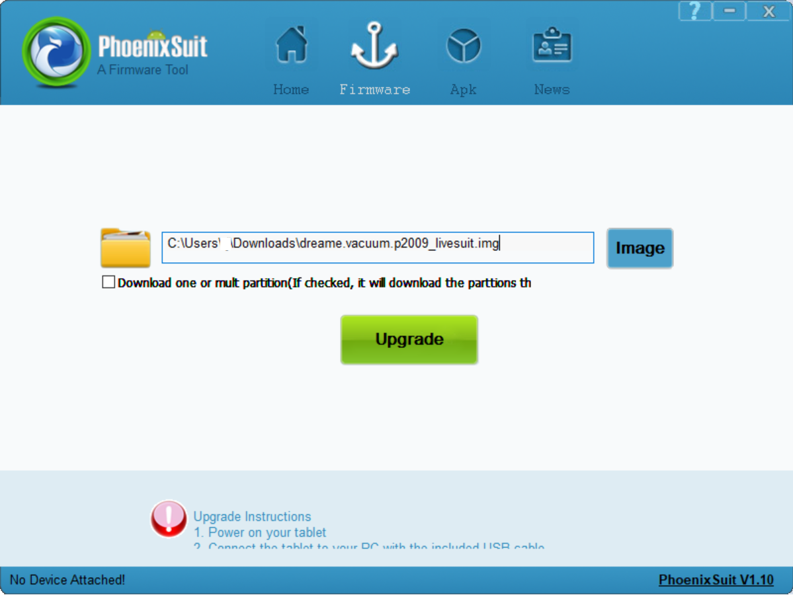
Root Step 1
Make sure that the robot is not connected over USB
Open Phoenixsuit and select image

Slide 33
Root Step 2
Boot the Robot in FEL mode
Connect MicroUSB to your computer (no USB hub, preferred USB 2.0 port)
Connect BOOT_SEL to GND
Use jumper wire (see 2a)
Basic adapter (see 2b)
Advanced adapter (see 2c)
Press the power button for 3 seconds
USB device should show up on your computer
You might need to install the Phoenixsuit drivers located in “Drivers/AW_Driver”
(via Device Manager -> Unknown Device -> Update drivers)
If that does not work, download it here: https://builder.dontvacuum.me/usbdriver.zip

Slide 34
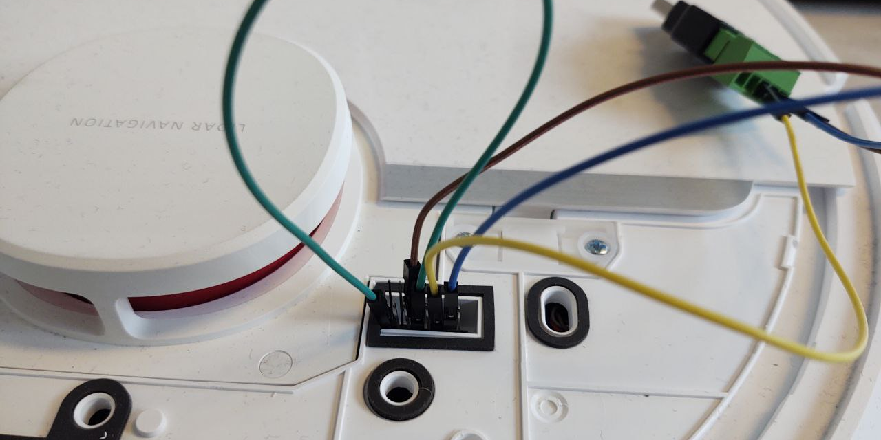
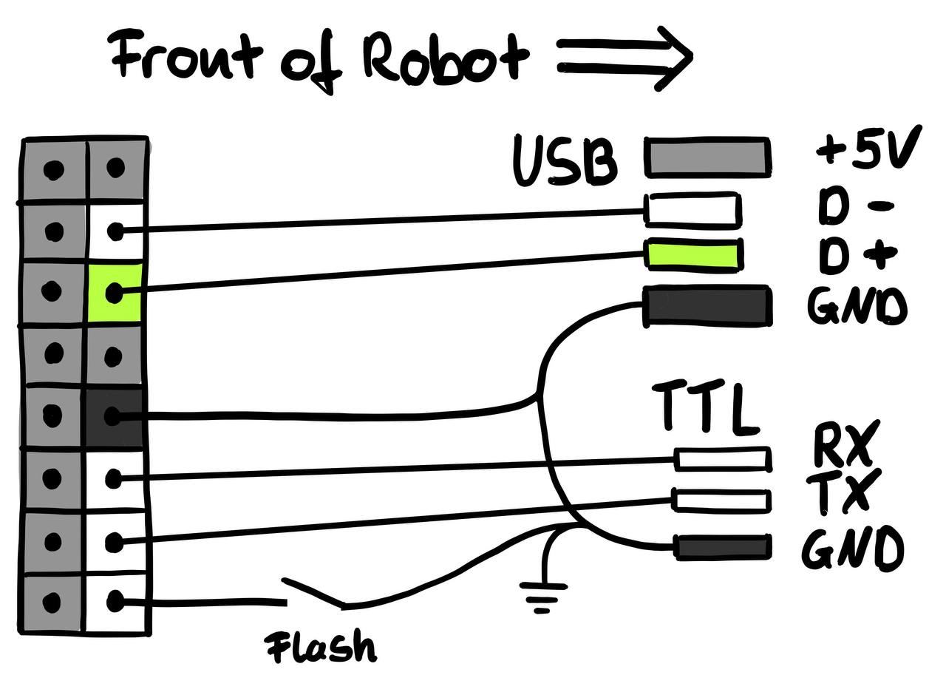
Root Step 2a
Jumper wires: Ideally you have 2mm headers
Make sure that the USB connection stays stable before you trigger the update (check the Windows Device Manager)
2.54 pitch jumper cables might fit but can cause issues

Slide 35
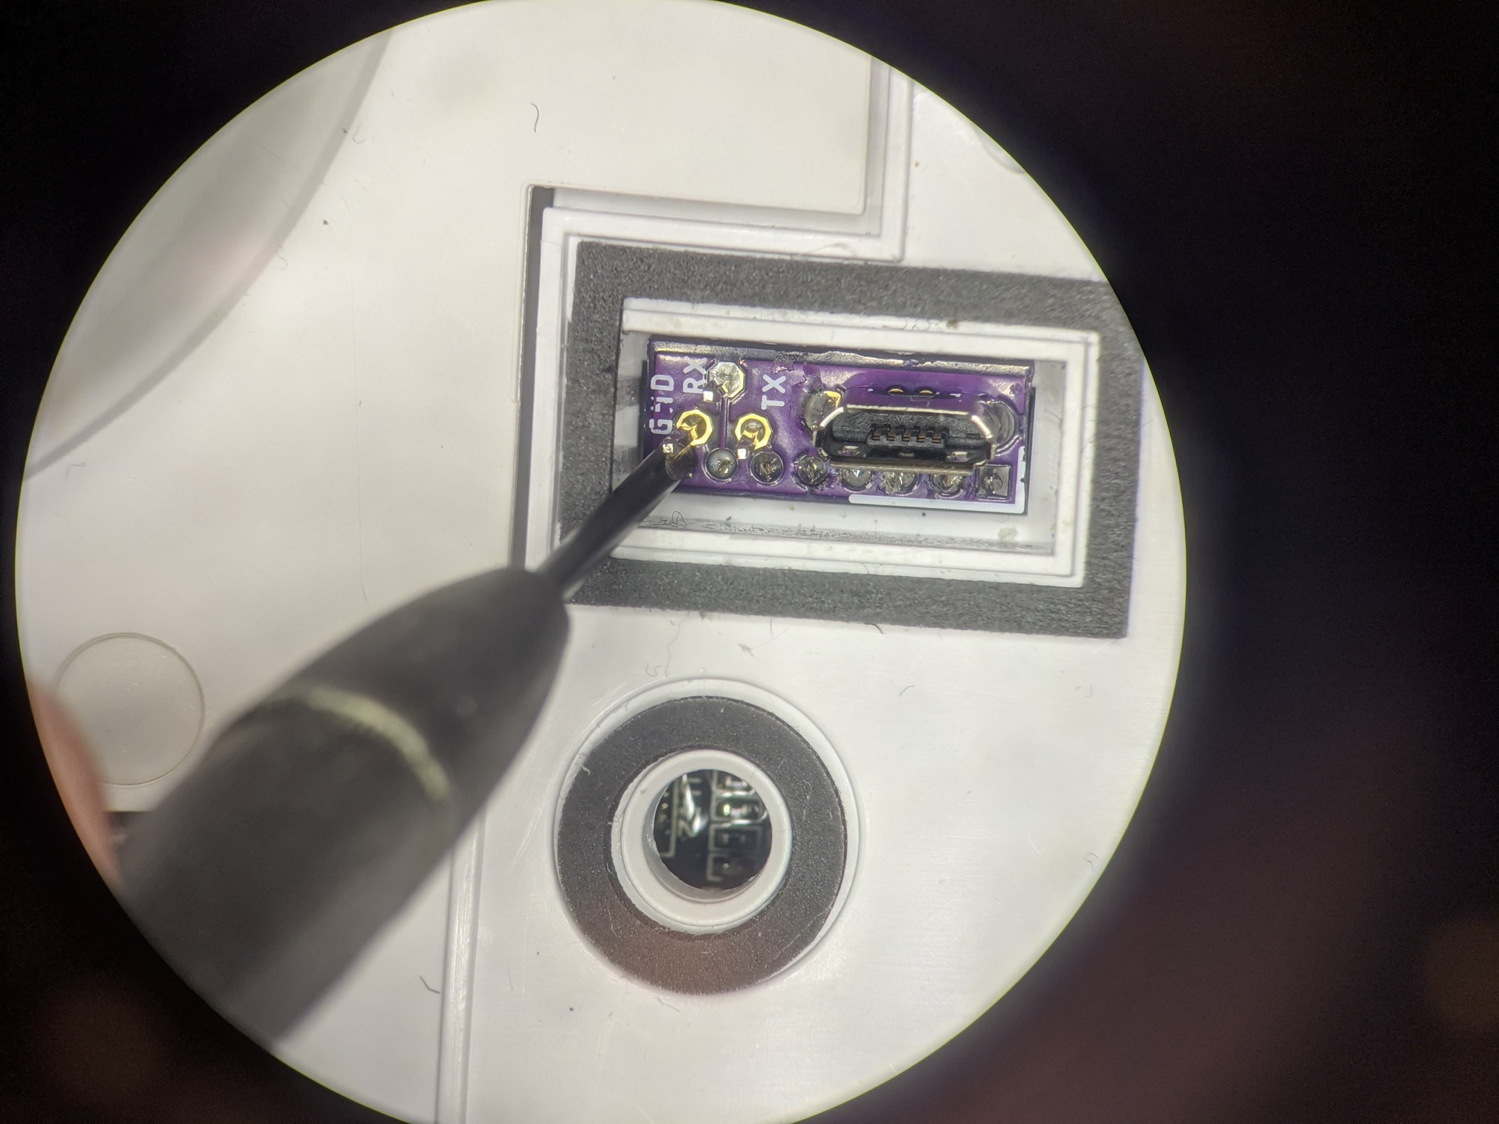
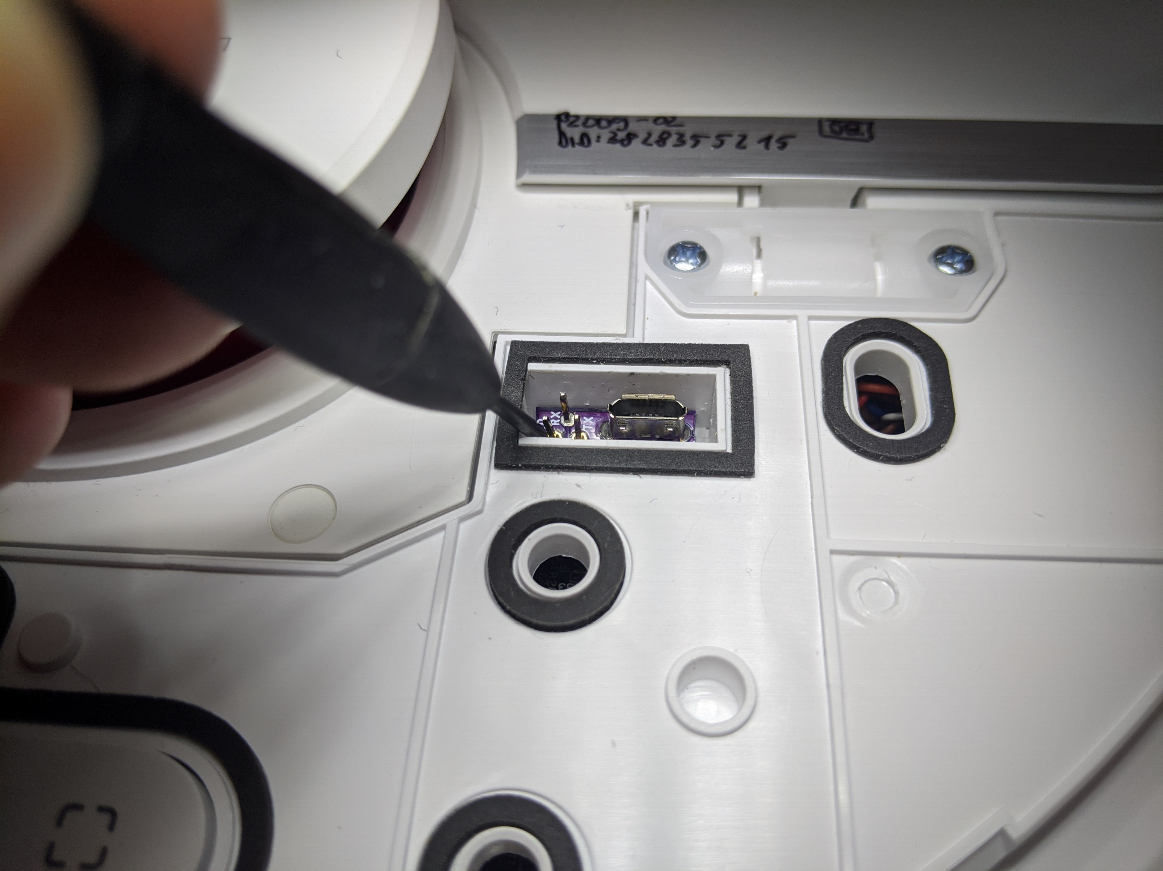
Root Step 2b
Basic PCB: Short the left pin to GND (e.g. with screwdriver)

Slide 36
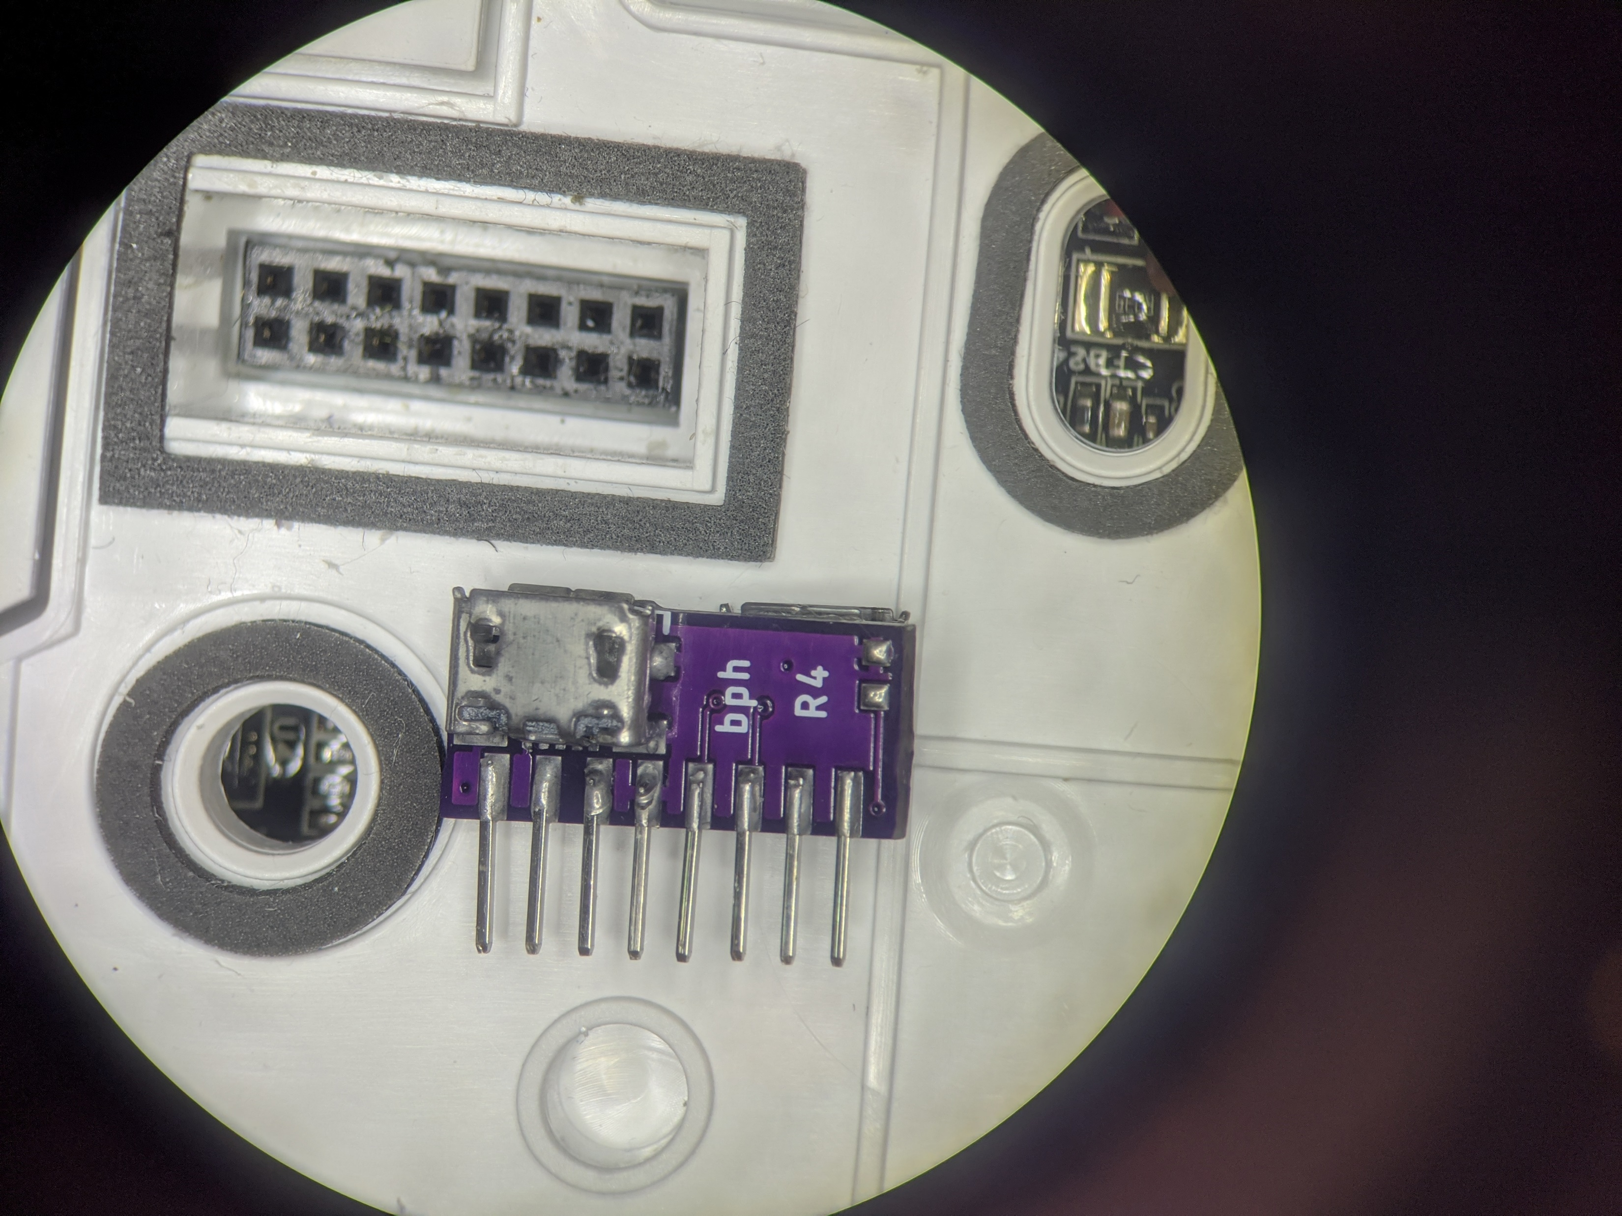
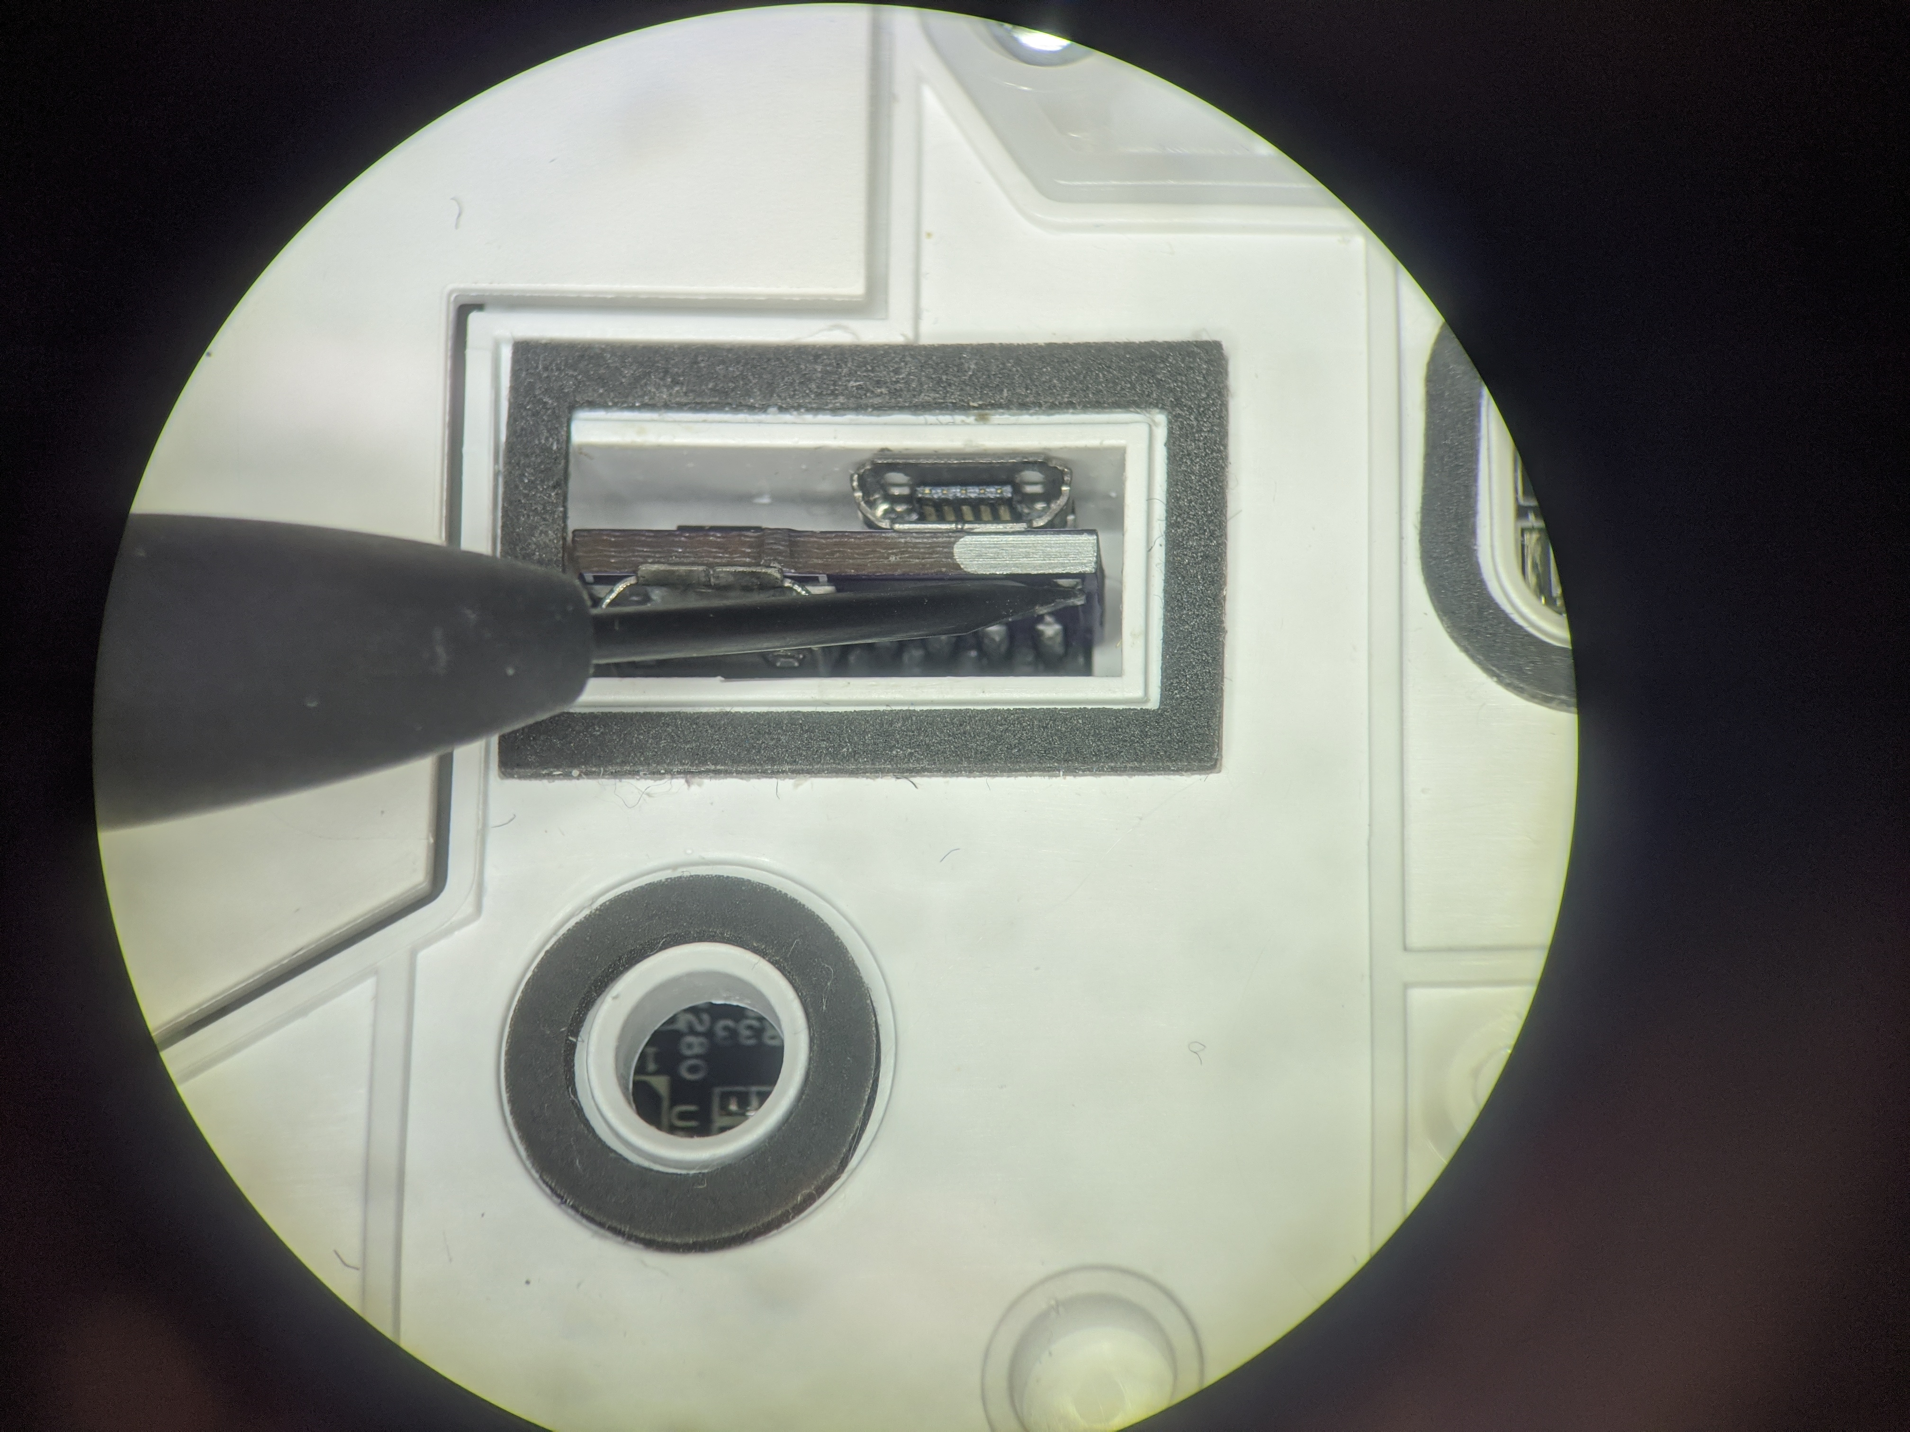
Root Step 2c
Advanced PCB: Short BOOT_SEL pads
BOOT_SEL

Slide 37
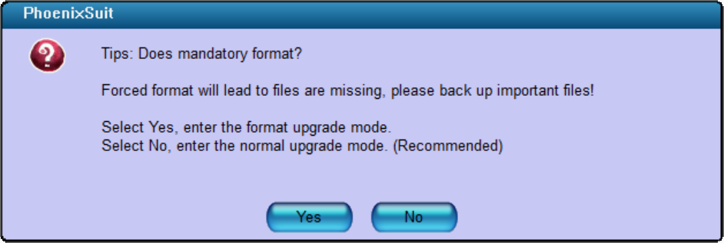
Root Step 3
Disconnect BOOT_SEL before proceeding
In Phoenixsuit
Click on Update
If asked about mandatory format, select “No” !
Wait for Update to finish

Slide 38
Root Step 3 Trouble shooting
Do not use USB hubs
If the device is detected initially, but disappears:
Try to use a different USB port
If you use VMs: Make sure that the USB filter is correct

Slide 39
You have now installed a custom firmware ;)

Slide 40
Customization of firmware
The firmware builder adds to hooks to the start process
/data/_root_sysconfig.sh (gets executed early)
/data/_root_postboot.sh (gets executed after boot)
At each boot we check for the presence of the custom files
Safety measurement: In case something goes wrong, a factory reset will delete this files
An example file can be found in /misc

Slide 41
Valetudo installation
Download valetudo binary to /data:
https://github.com/Hypfer/Valetudo/releases
Device dependent (check our website):
1C, F9, D9: valetudo-armv7-lowmem
1T, L10 Pro: valetudo-aarch64
“wget https://github.com/Hypfer/Valetudo/releases/latest/download/valetudo-armv7-lowmem -O /data/valetudo”
Make valetudo executable
“chmod +x /data/valetudo”
Enable boot script
“cp /misc/_root_postboot.sh.tpl /data/_root_postboot.sh”
“chmod +x /data/_root_postboot.sh”
Reboot
Check https://builder.dontvacuum.me/dreame/cmds.txt for a copy-pastable command list

Slide 42
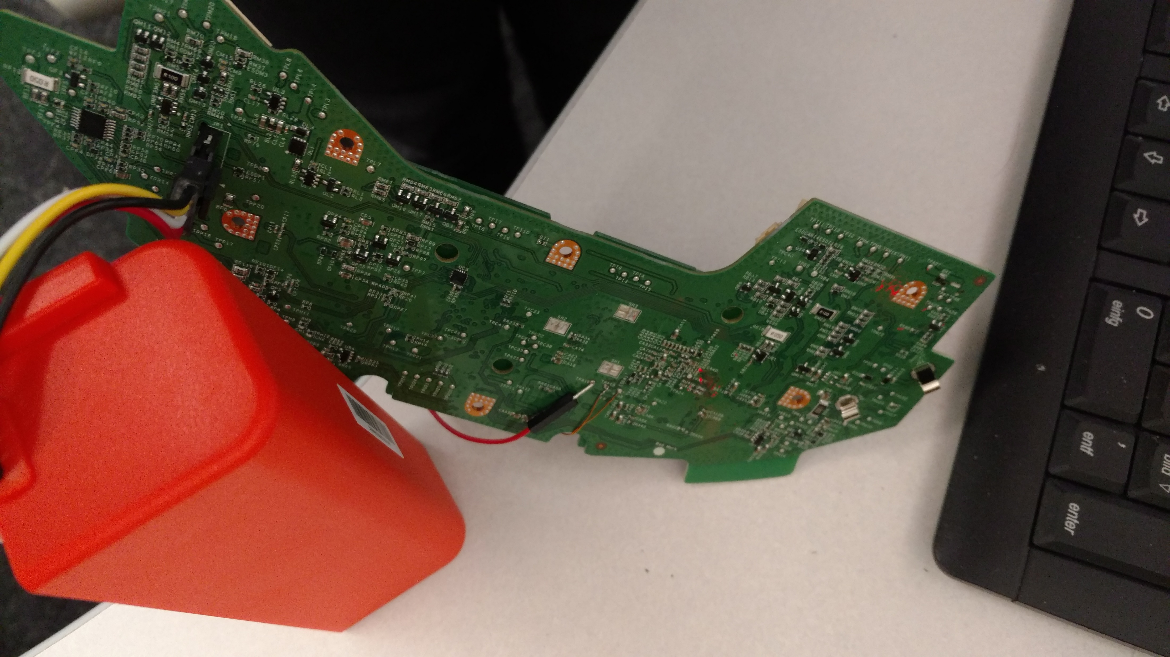

Thank you for watching!
@dgi_DE
Website: dontvacuum.me

